Slide 1
THIS IS GOING TO GO FAST... DON’T BLINK

Slide 2
“...And some said, ‘what will this babbler say?’”
Acts 17:18

Slide 3
Who are these upstart newcomers?... And what could they possibly have to say that we would want to hear?

Slide 4
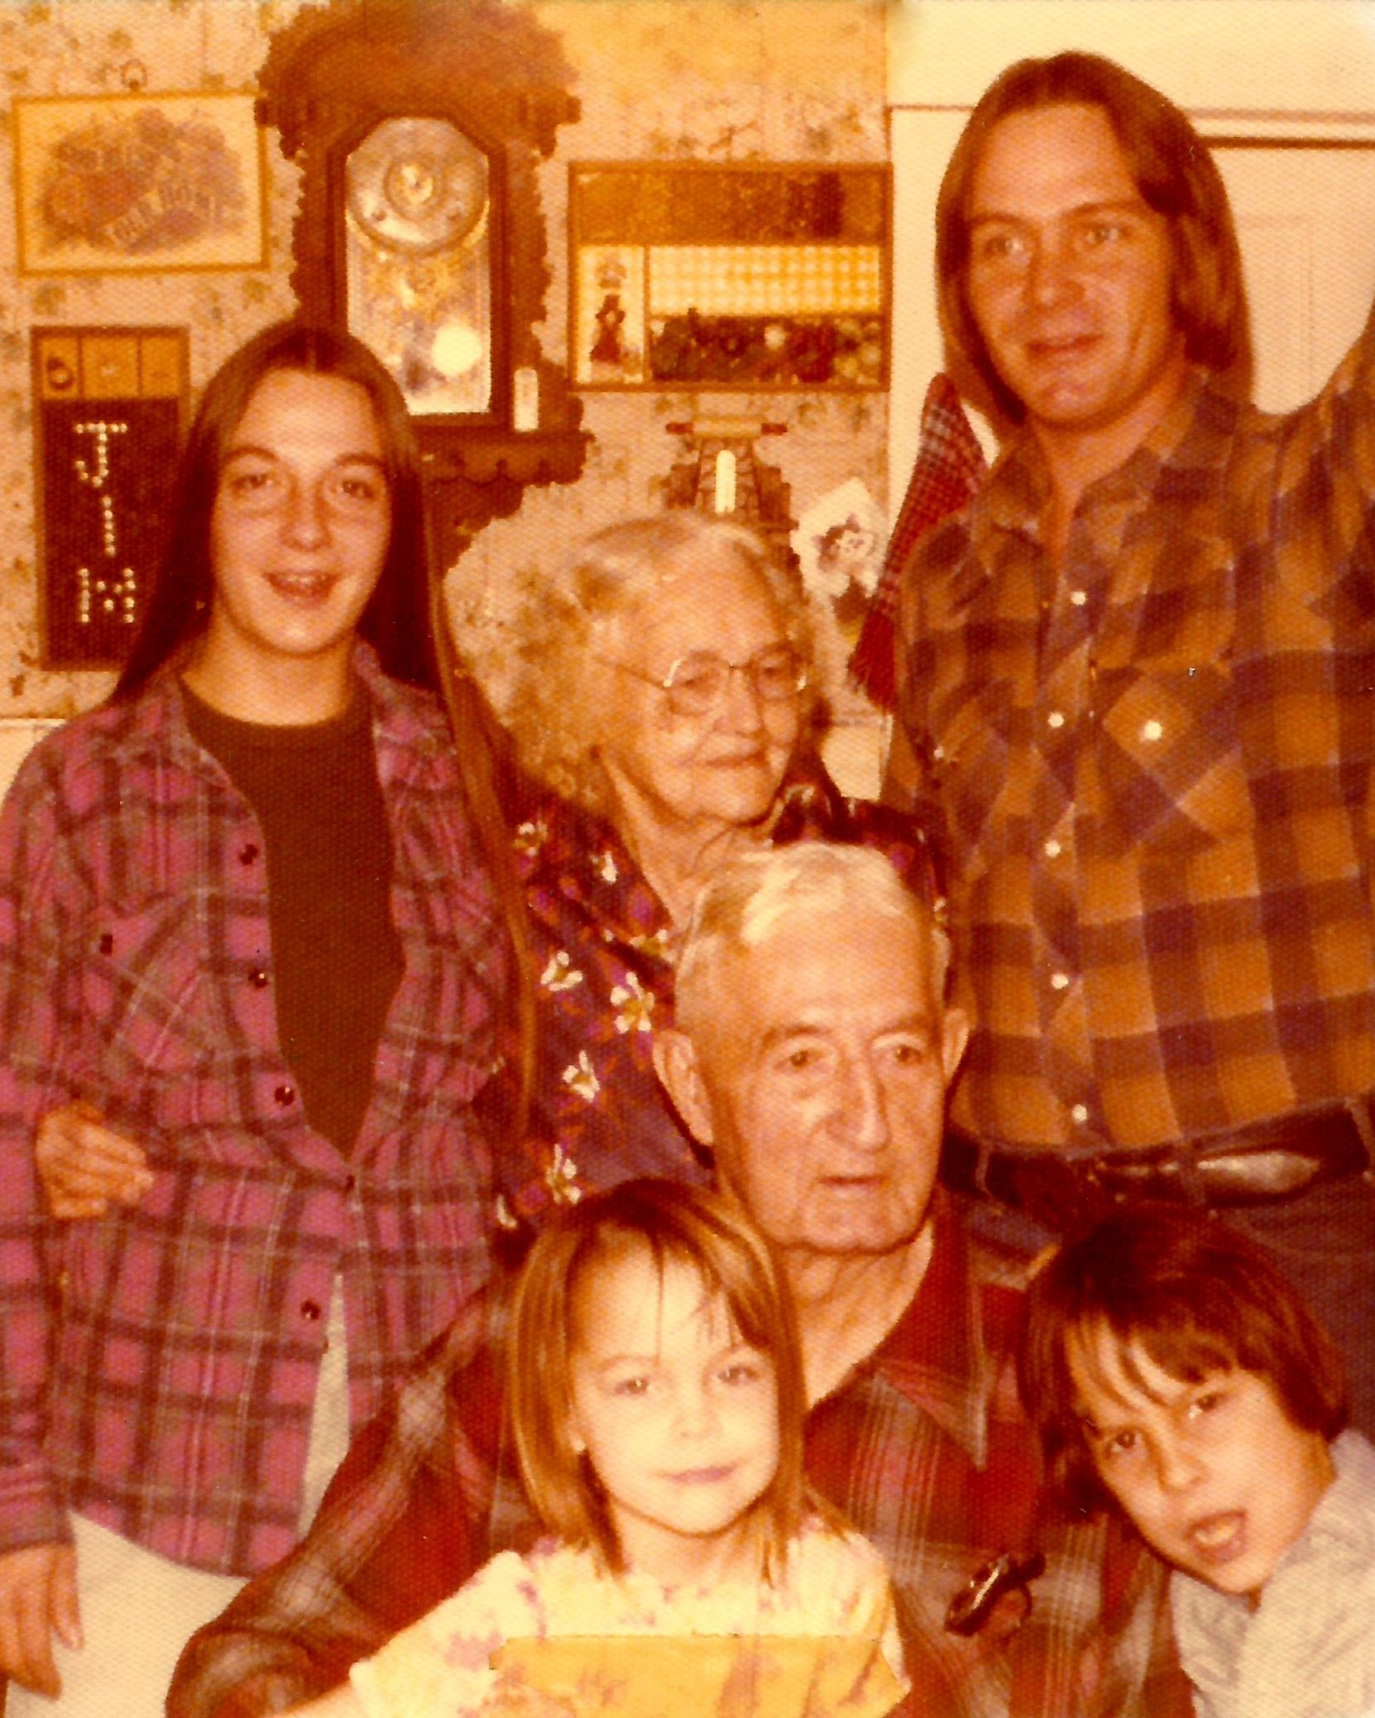
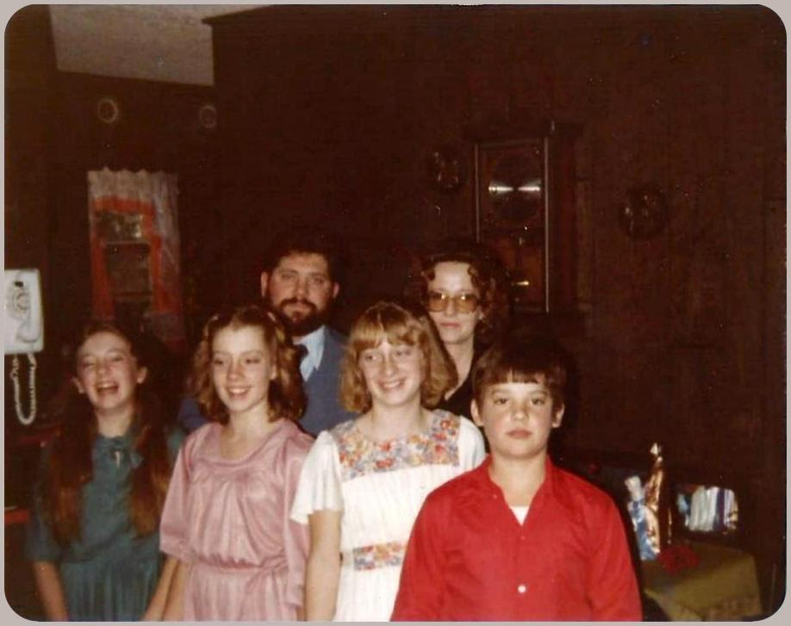
Who we are:

Slide 5
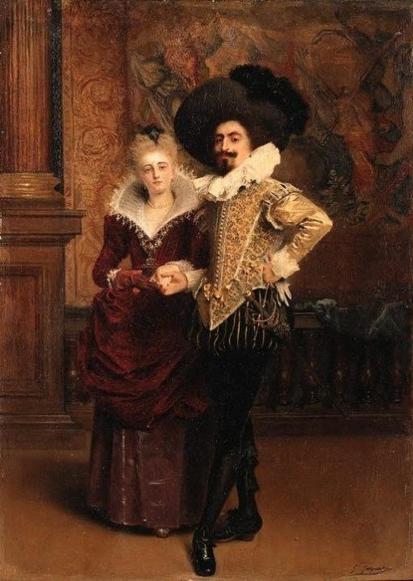
Who we are not:

Slide 6
We are designers!
We design all kinds of things!

Slide 7
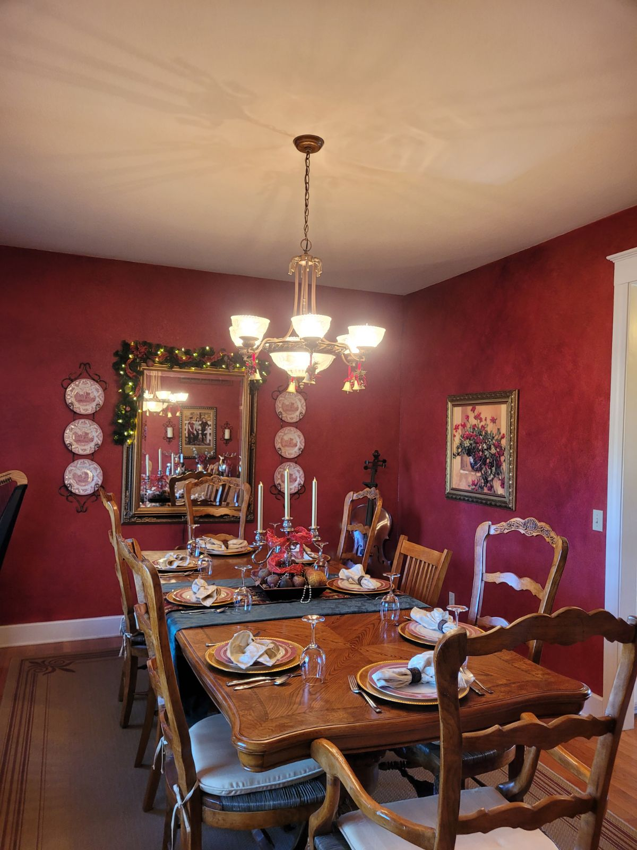
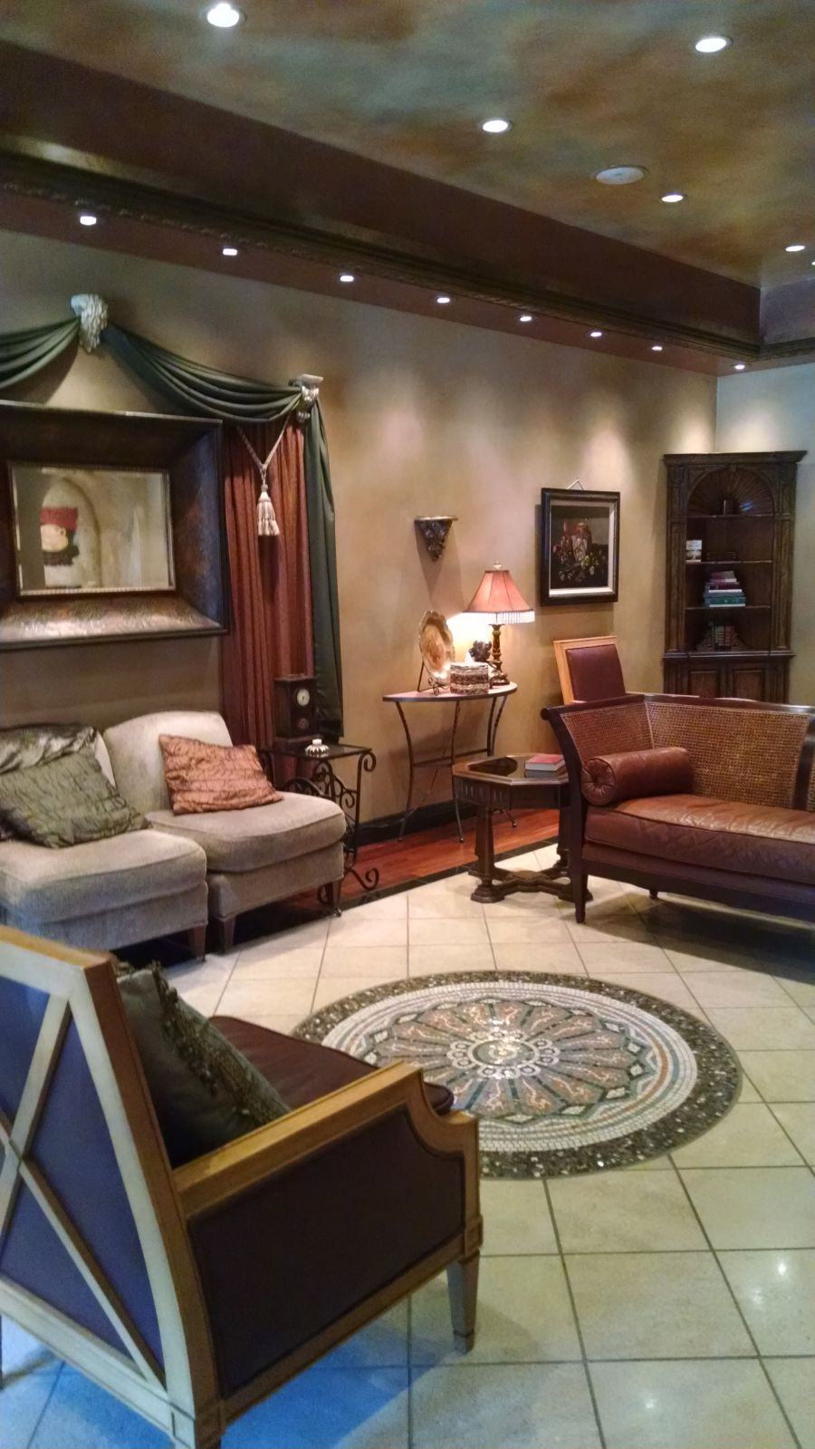
Some fancy…

Slide 8
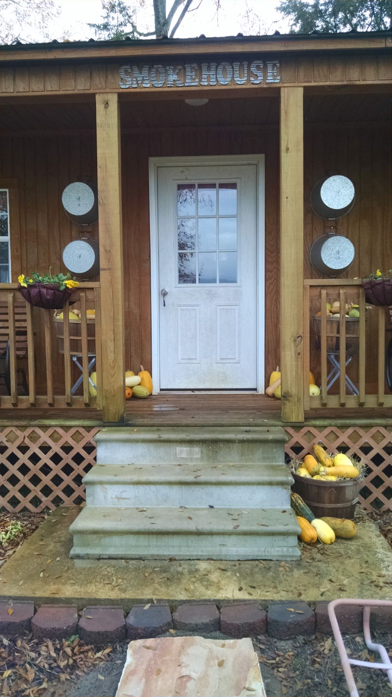
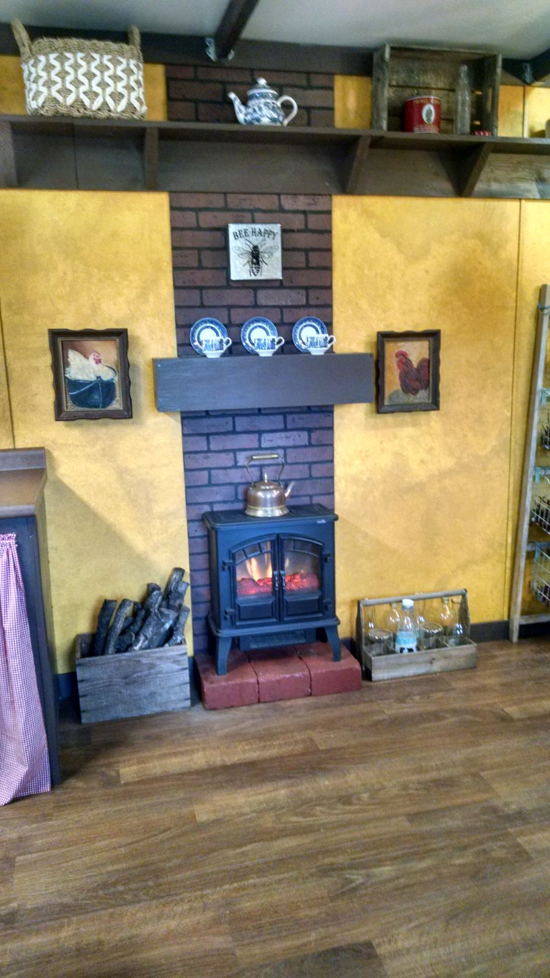
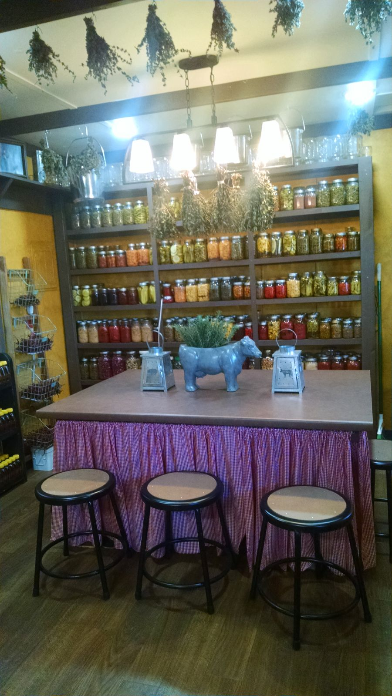
Some, not so fancy…

Slide 9
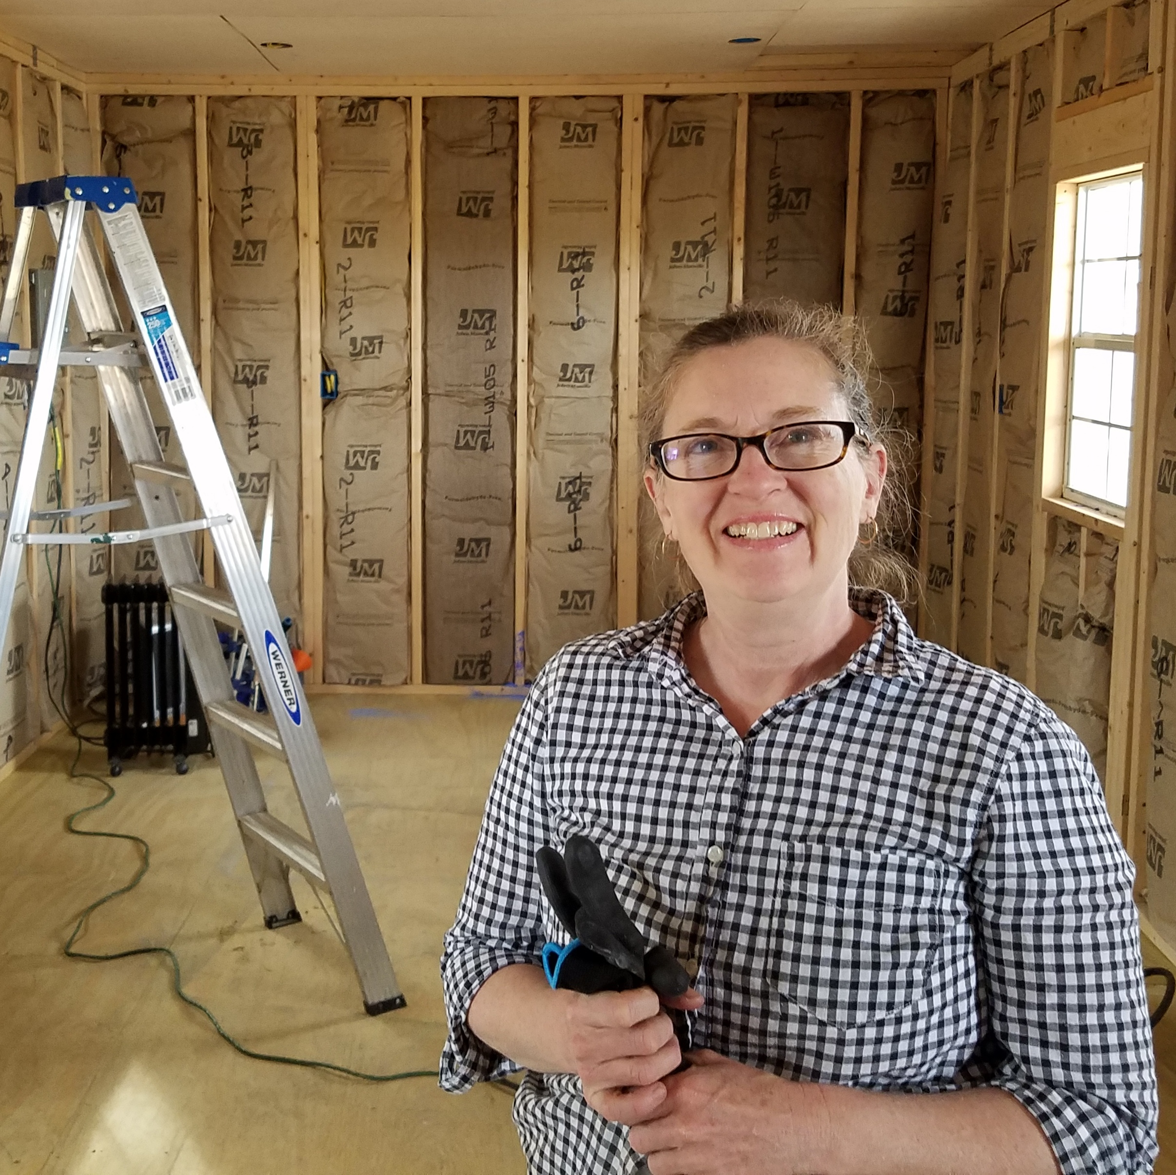
Laura Cotner
Extrovert
Ambushes visitors in the narthex
Invades personal space
Enthusiastic
Interior decorator/ landscape designer
Experience in trim carpentry, drywall, painting and working with clients
Areas of special emphasis
Style
Symmetry, balance
Color theory

Slide 10
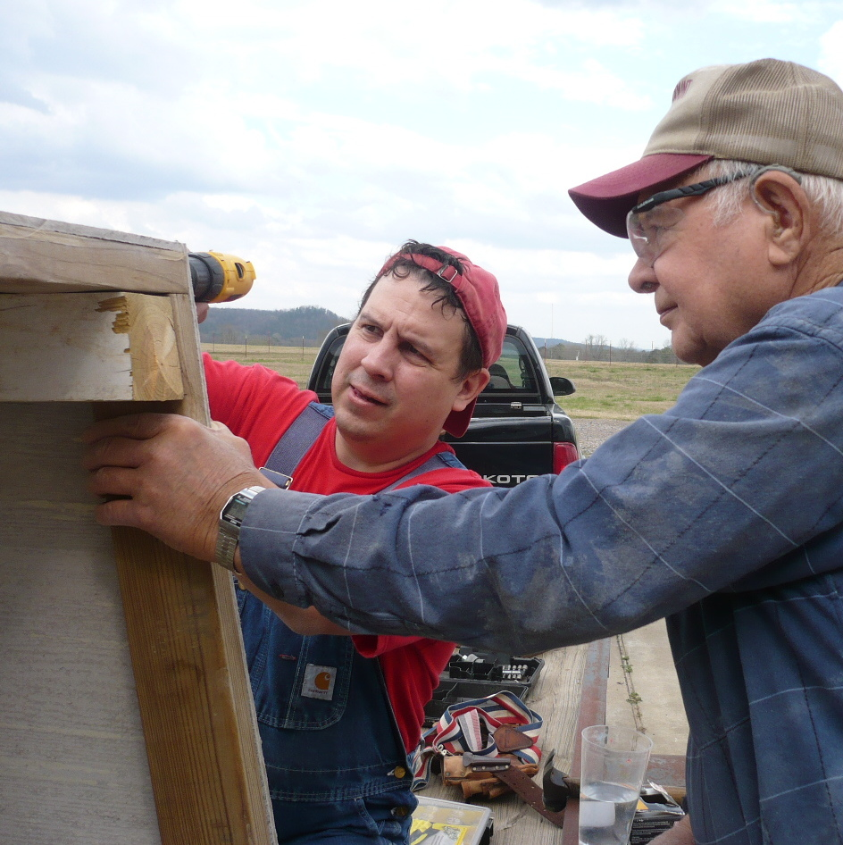
Brian Cotner
Sage of Solomonic wisdom
Slow to speak
Quick to listen
Puts up with a lot
Copes well with embarrassment
Interior designer / exterior designer / concept artist
Degree in art, worked as commercial artist
Experience in construction
Areas of special emphasis:
Solving flow problems
Optimizing use of space
Conserving existing structures

Slide 11
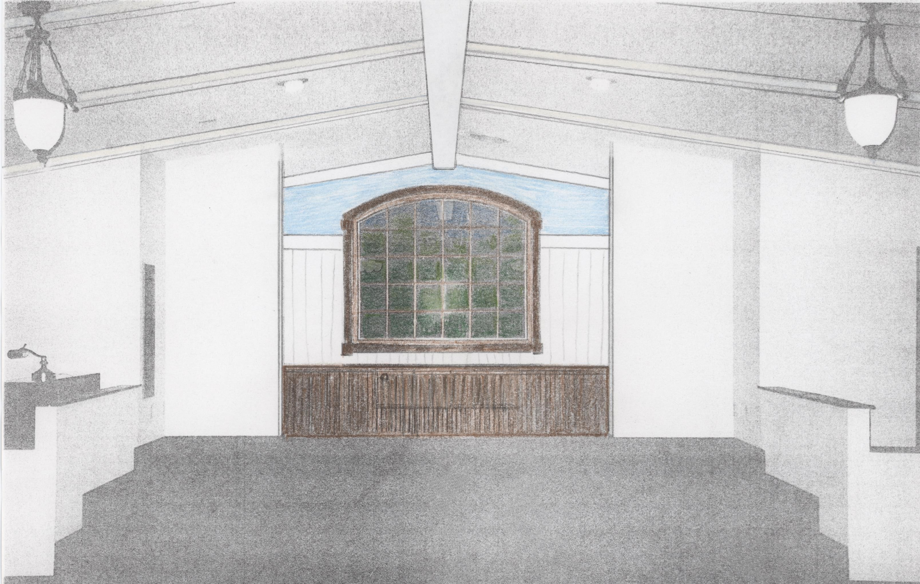

Slide 12
Brian Cotner
Sage of Solomonic wisdom
Slow to speak
Quick to listen
Puts up with a lot
Copes well with embarrassment
Interior designer / exterior designer / concept artist
Degree in art, worked as commercial artist
Experience in construction
Areas of special emphasis:
Solving flow problems
Optimizing use of space
Conserving existing structures

Slide 13
What is the difference between an interior designer & an interior decorator?
Designers - focus on optimizing structures and spaces (Brian)
Decorators - focus on dressing that structure and space (Laura)
We’ve worked together so long that we’ve learned lots about each other’s jobs.

Slide 14
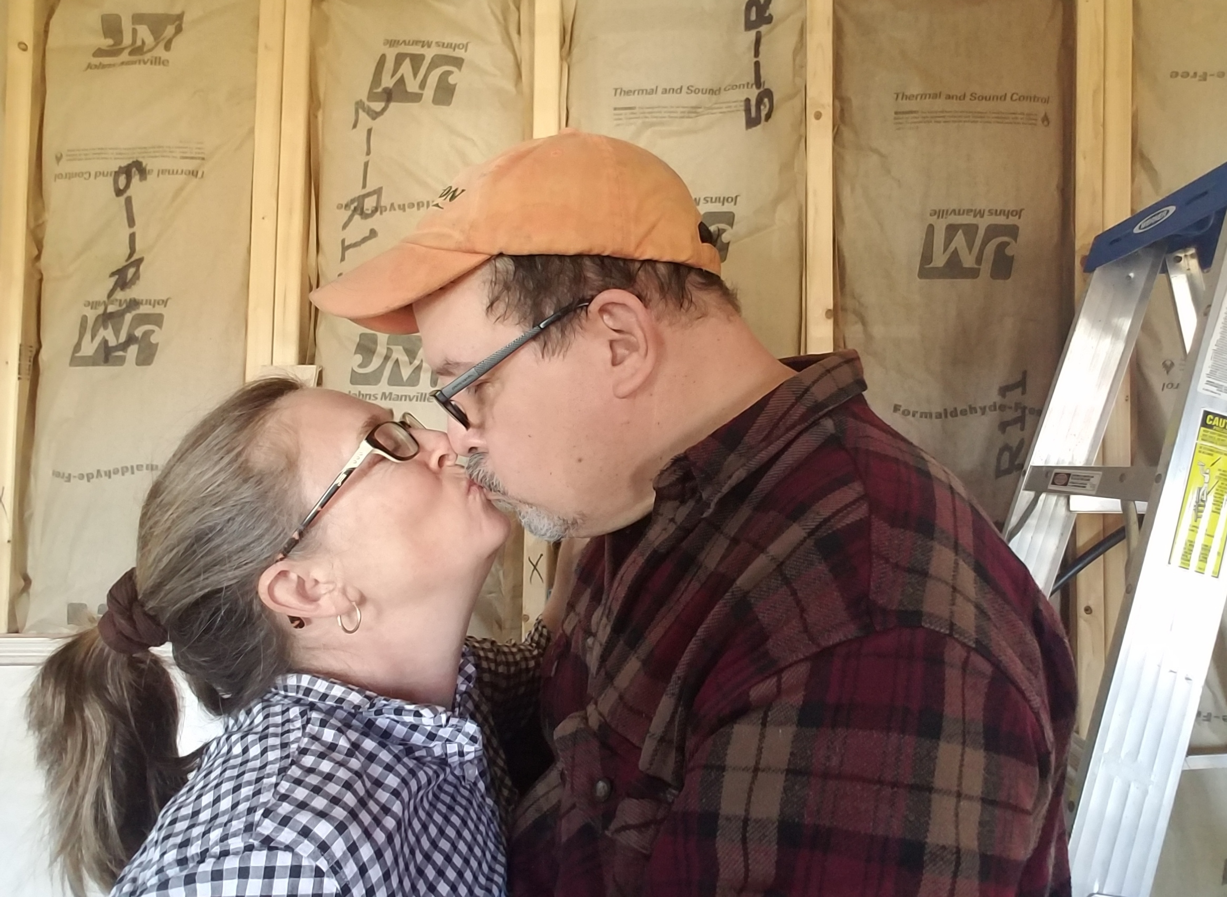
“...These that have turned the world upside down have come hither also!”
Acts 17:6

Slide 15
Combined job experience
Private homes
Professional offices
Clinics
Churches

Slide 16
Private Homes

Slide 17
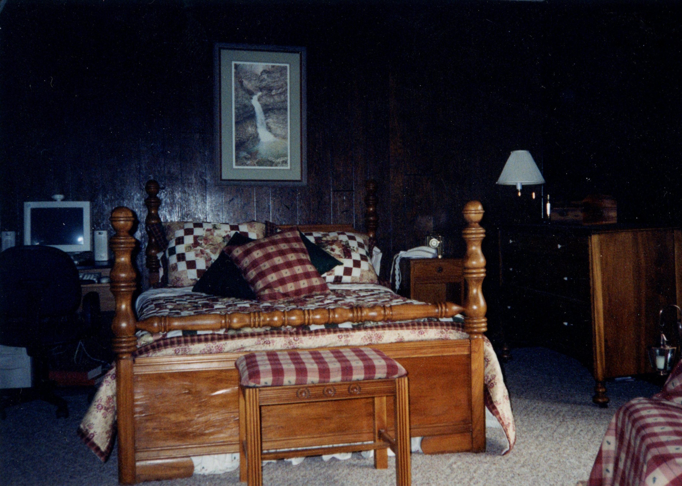
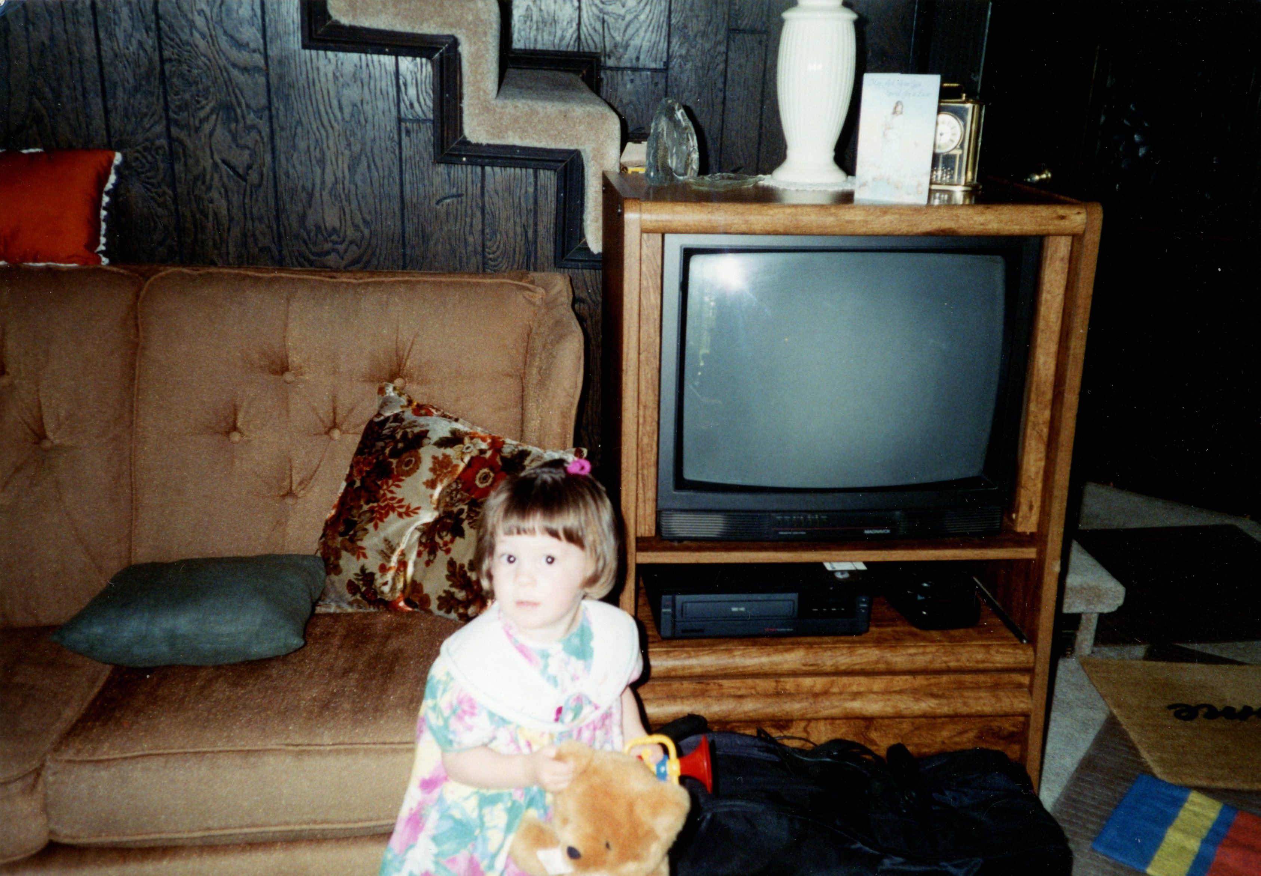

Slide 18
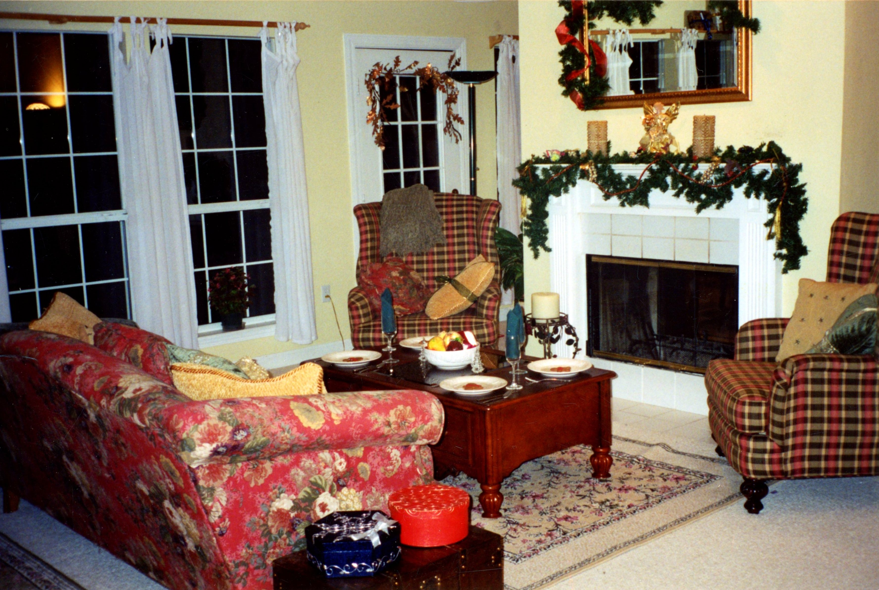
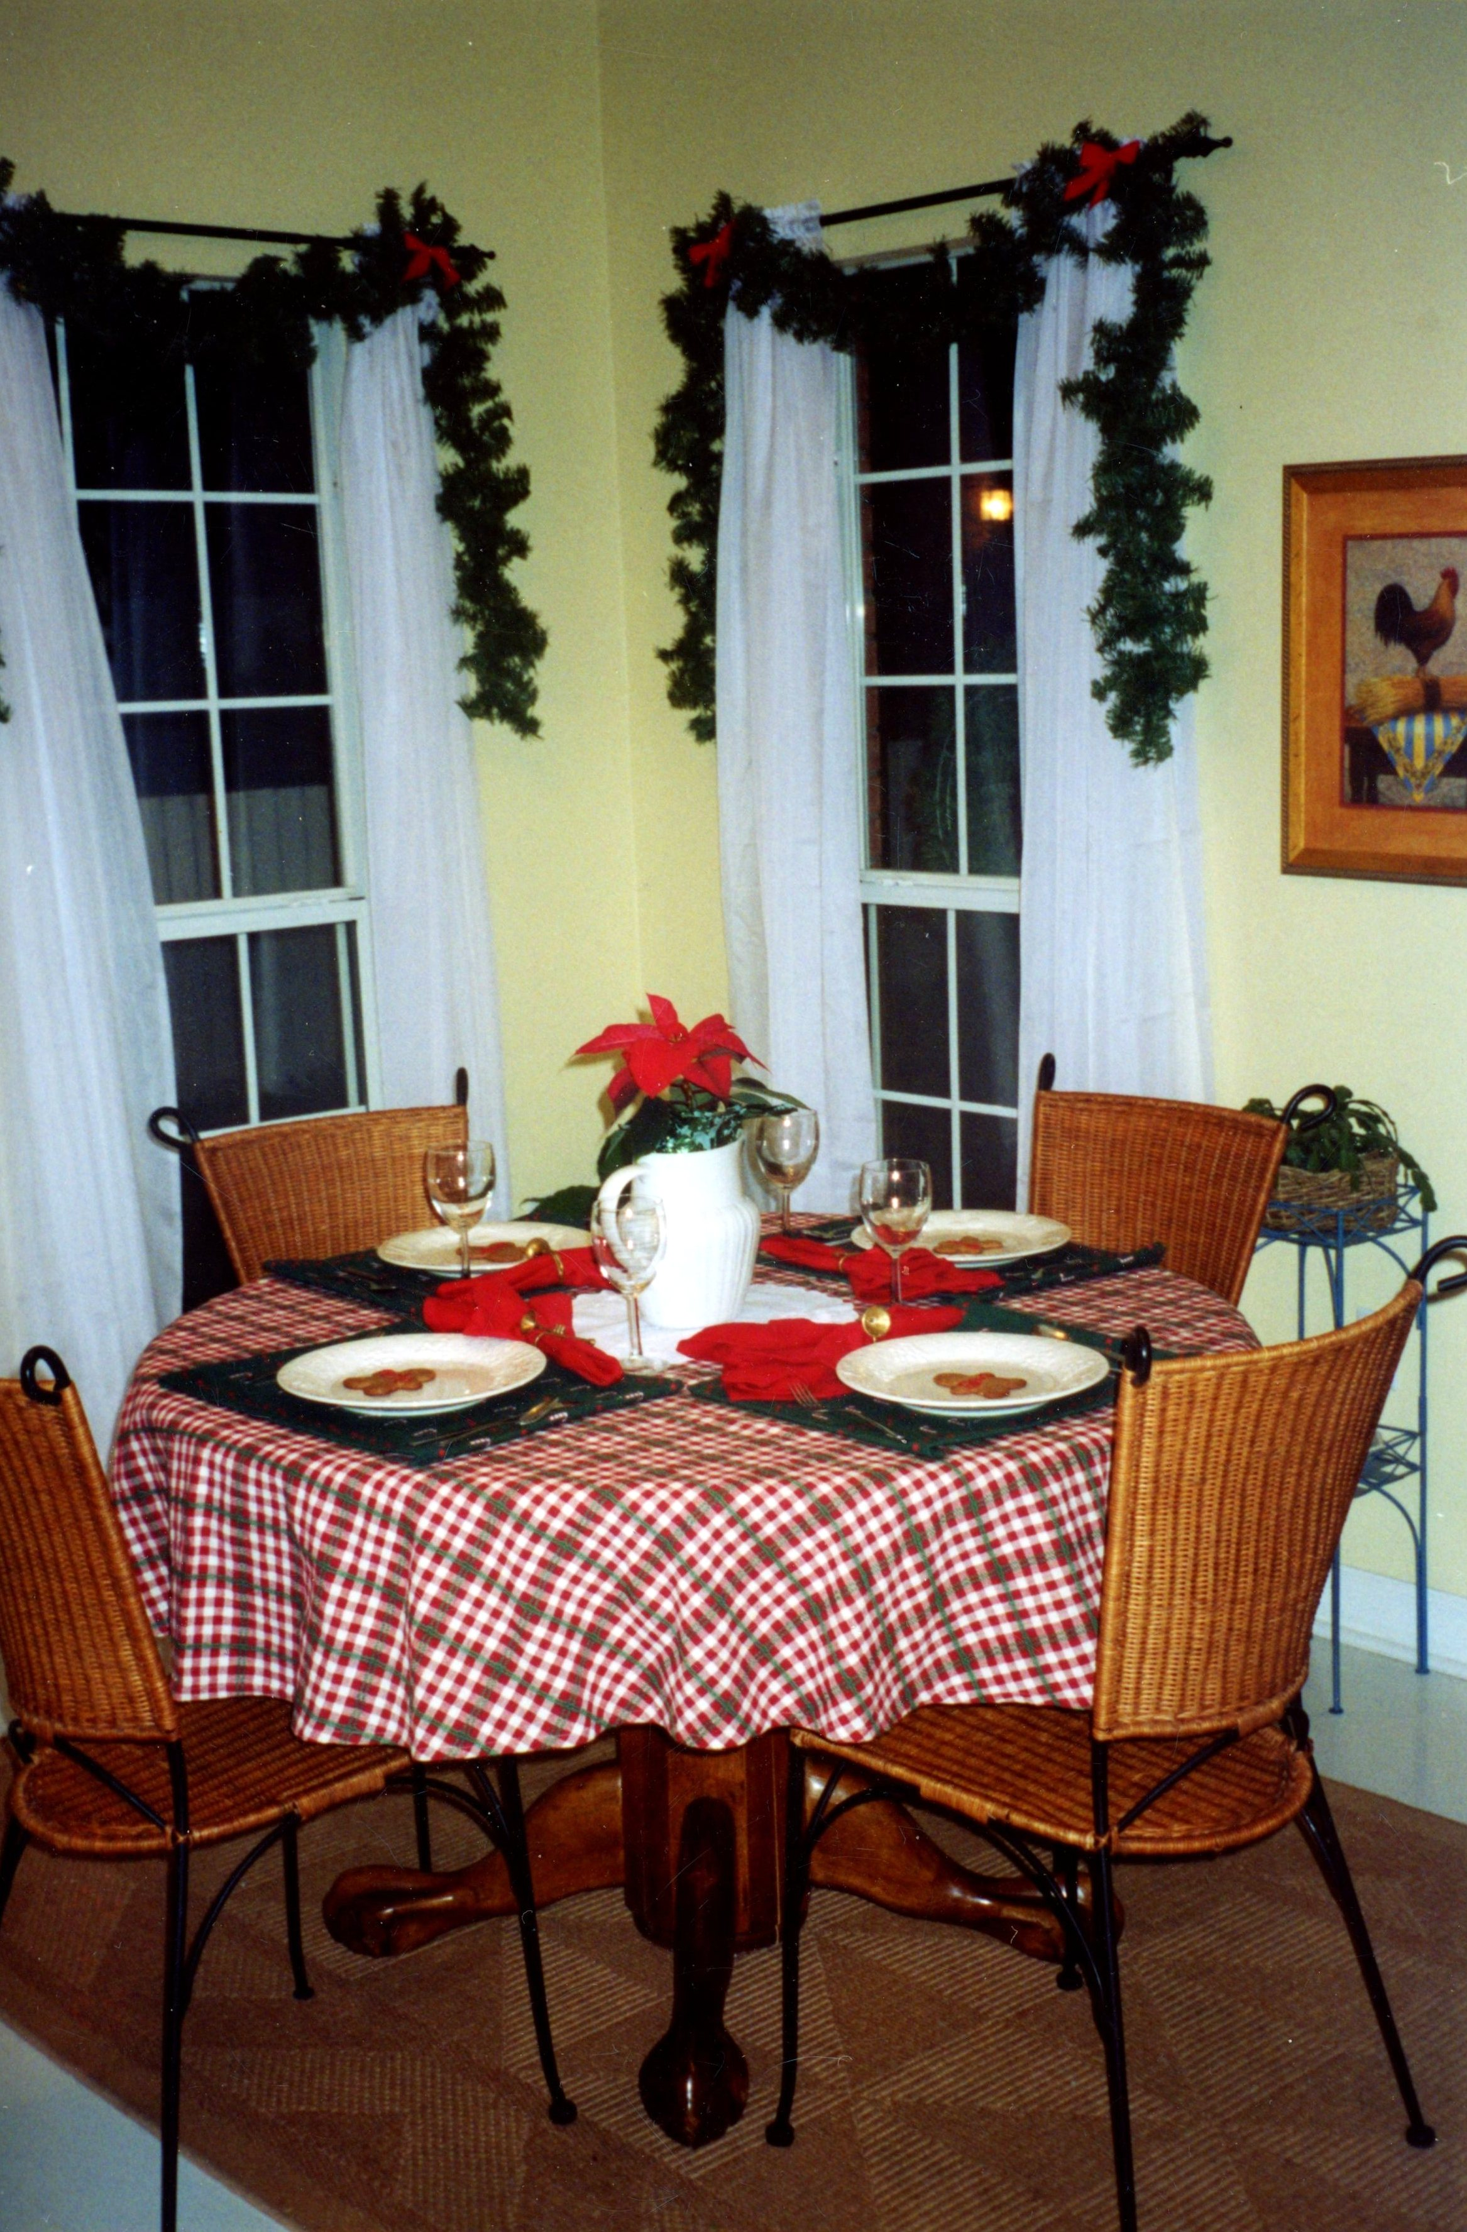

Slide 19
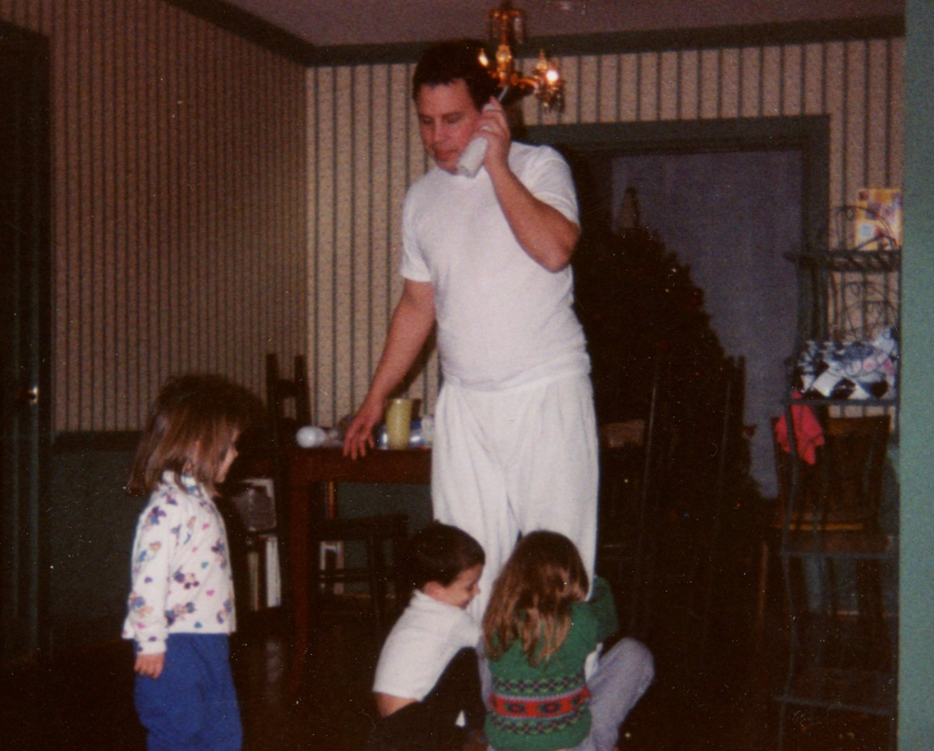
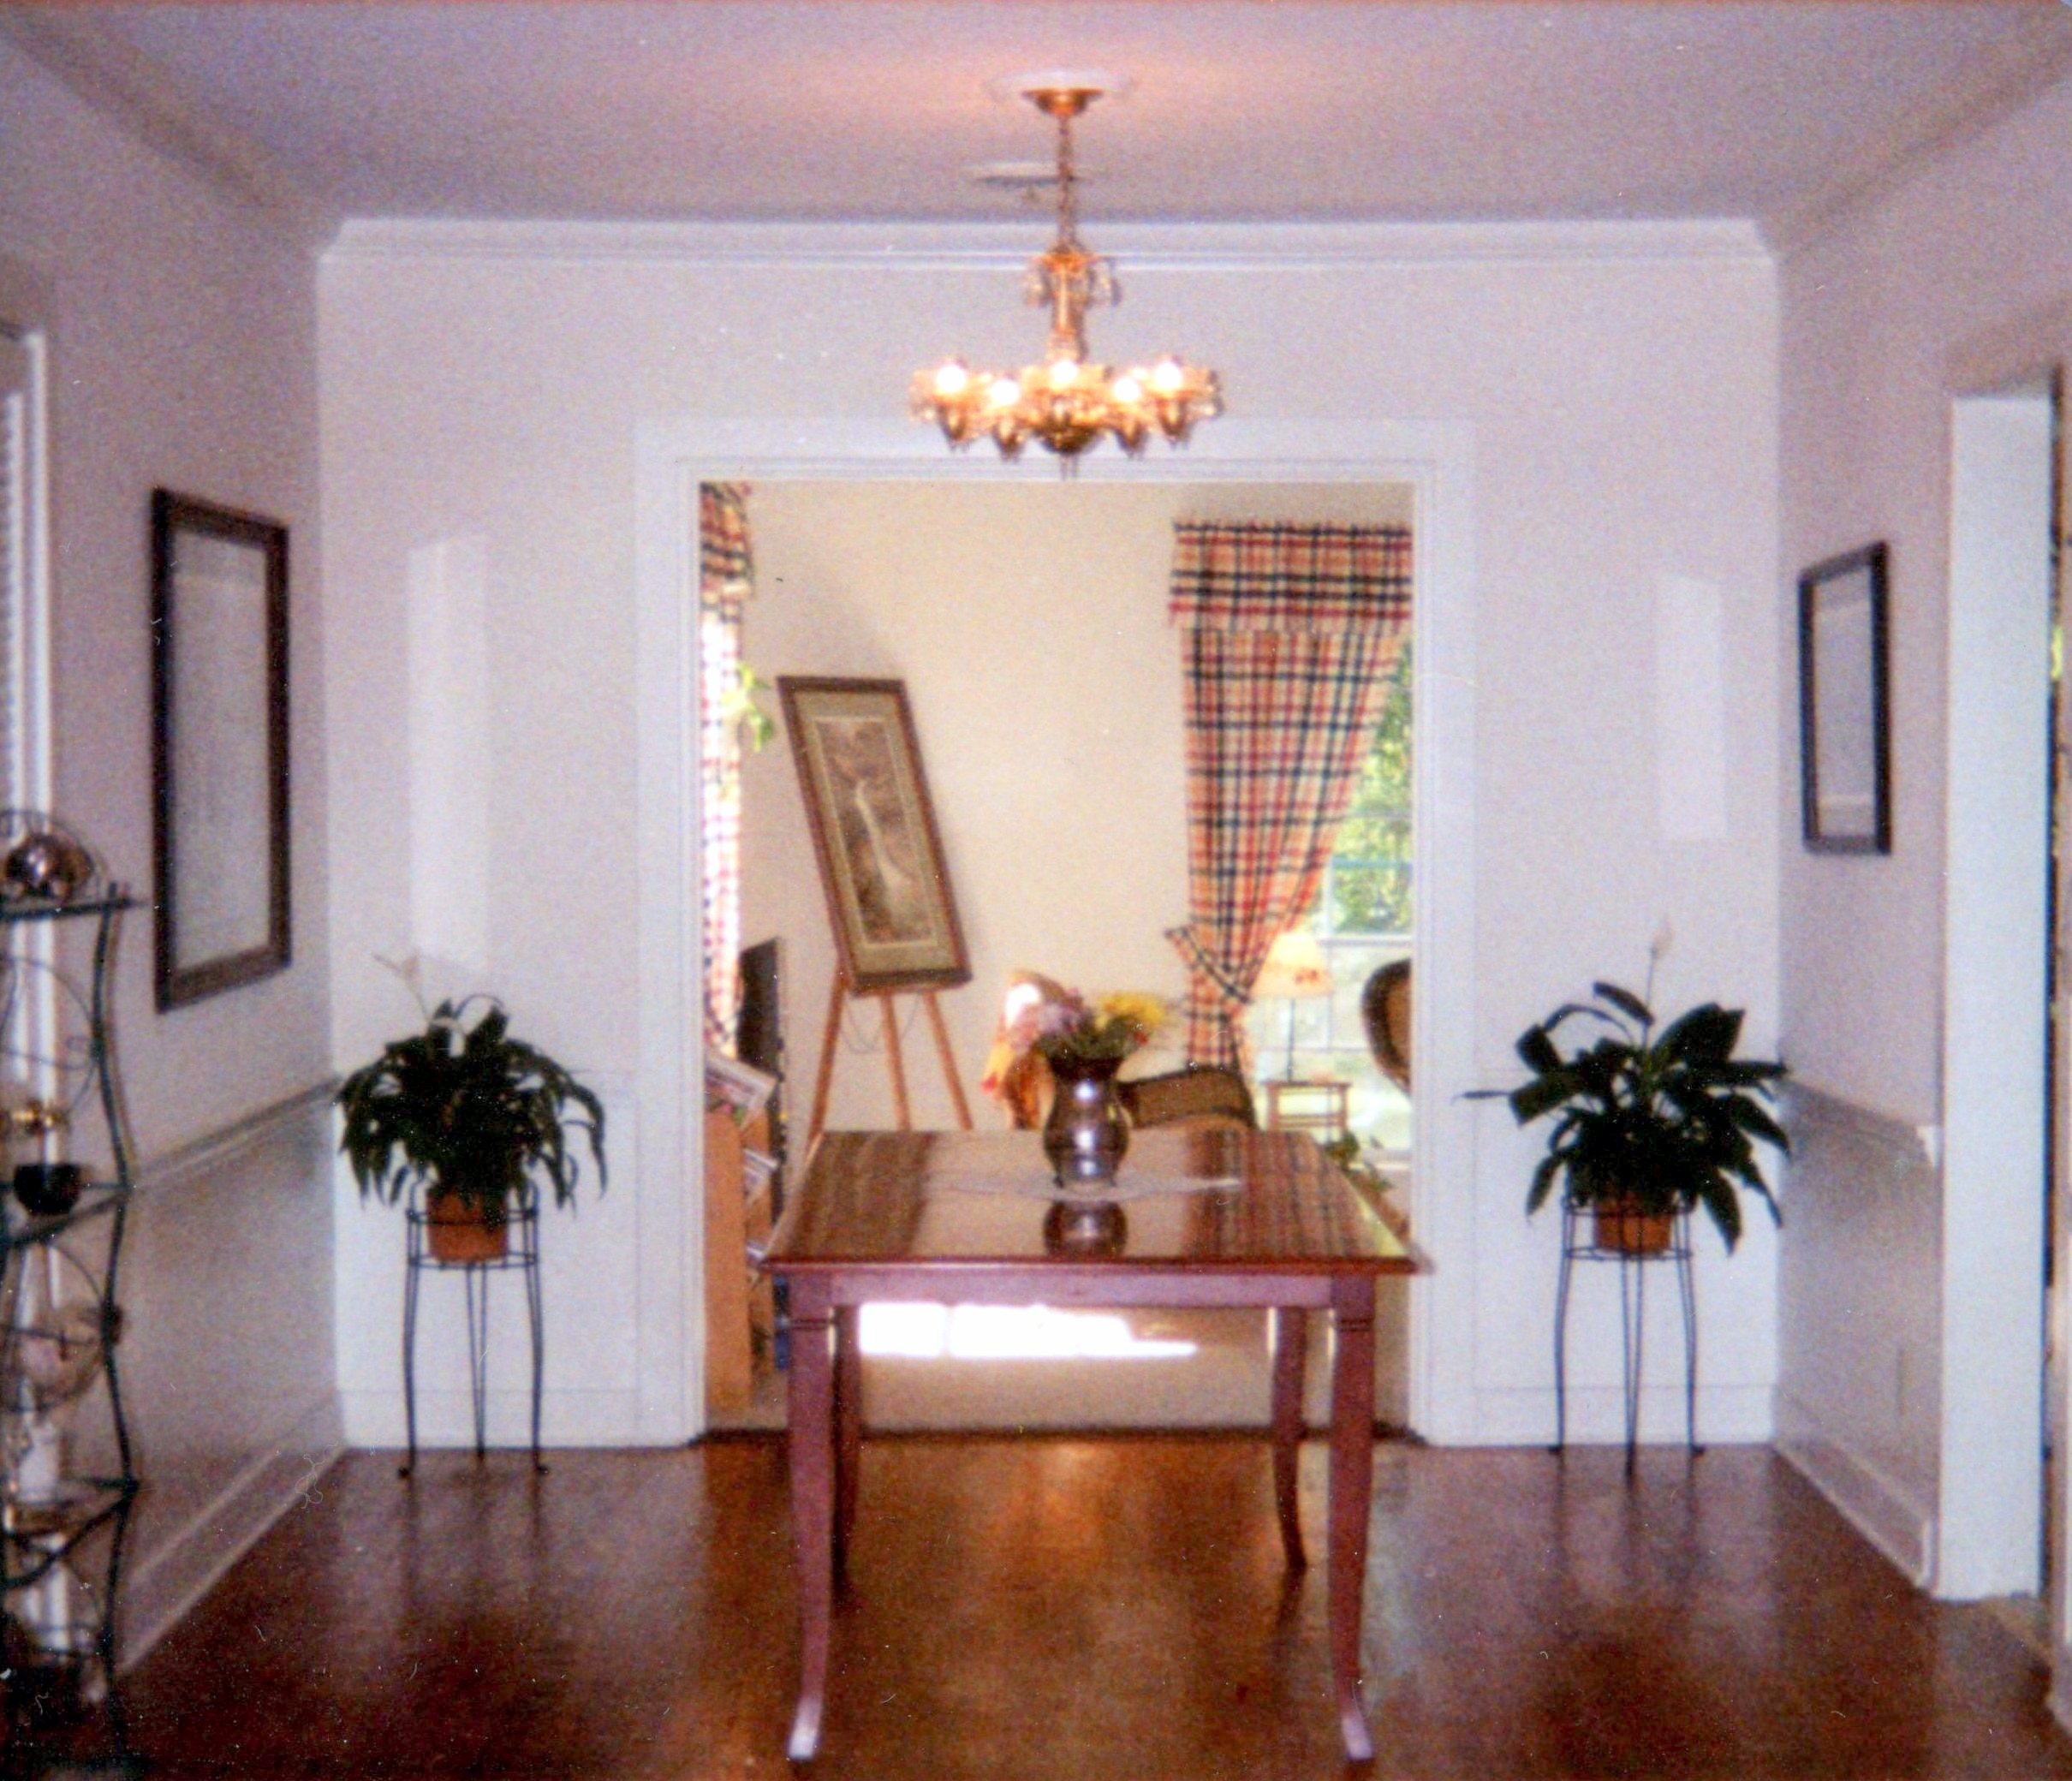
BEFORE:
AFTER:

Slide 20
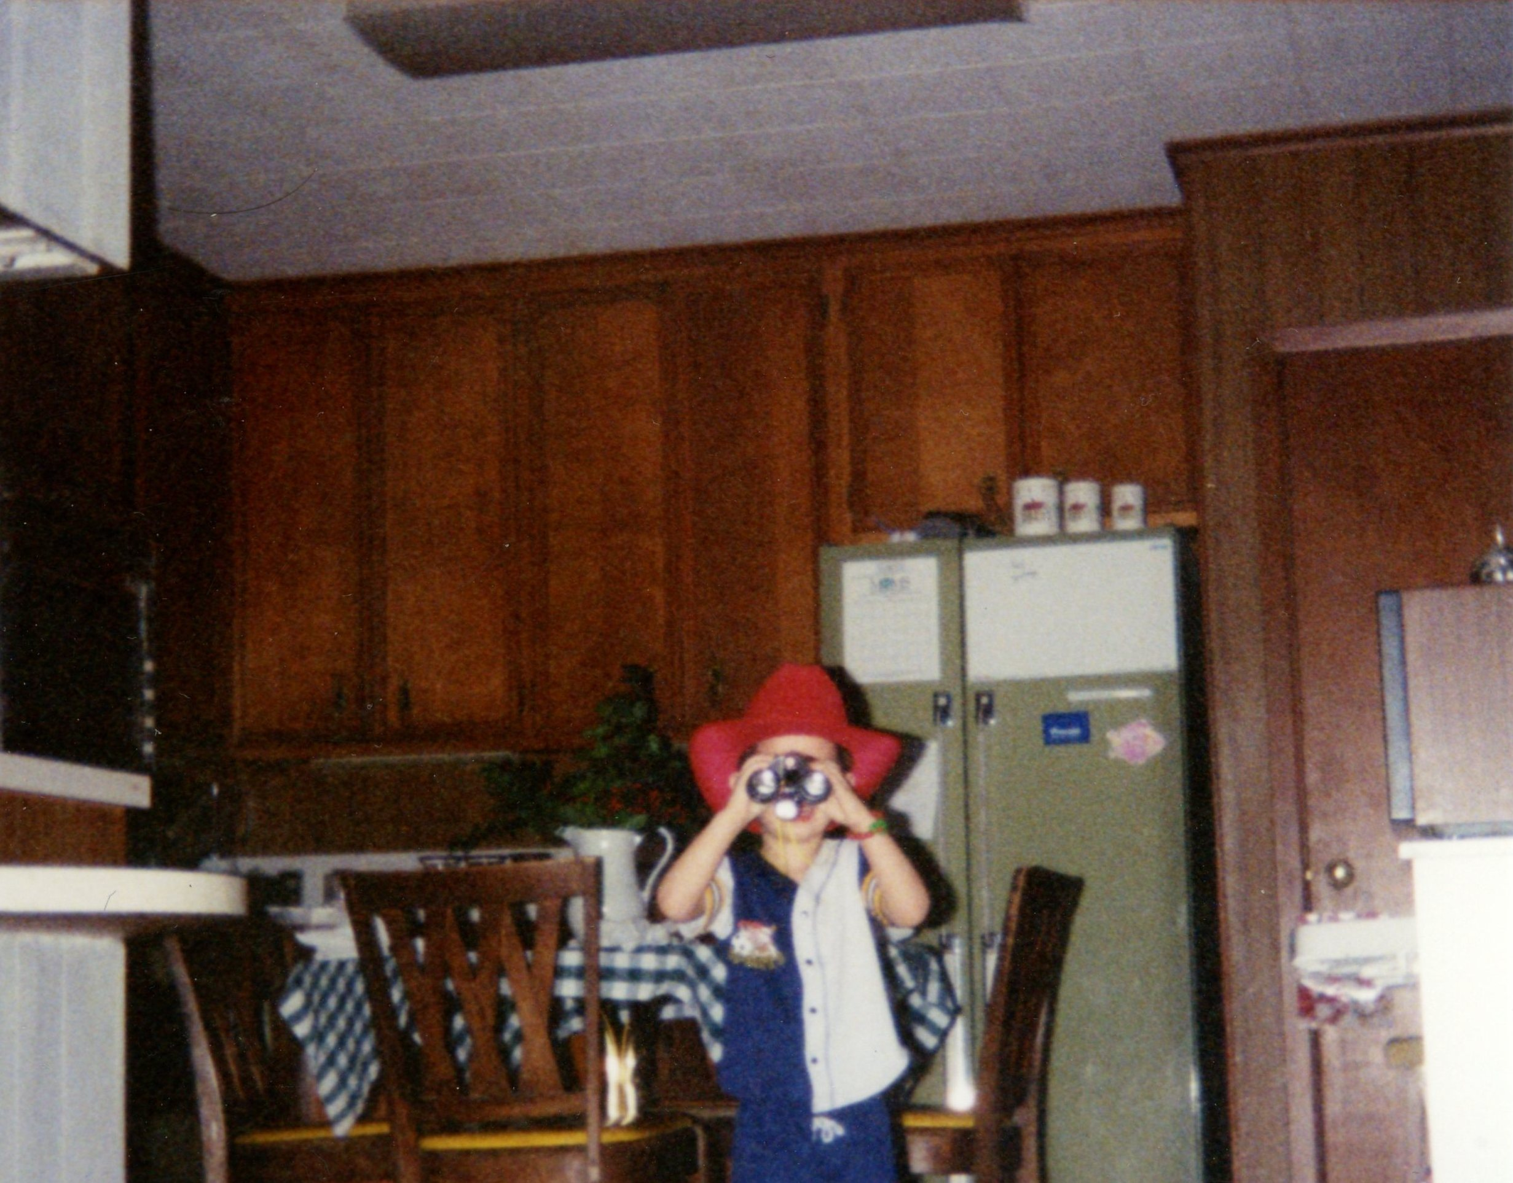
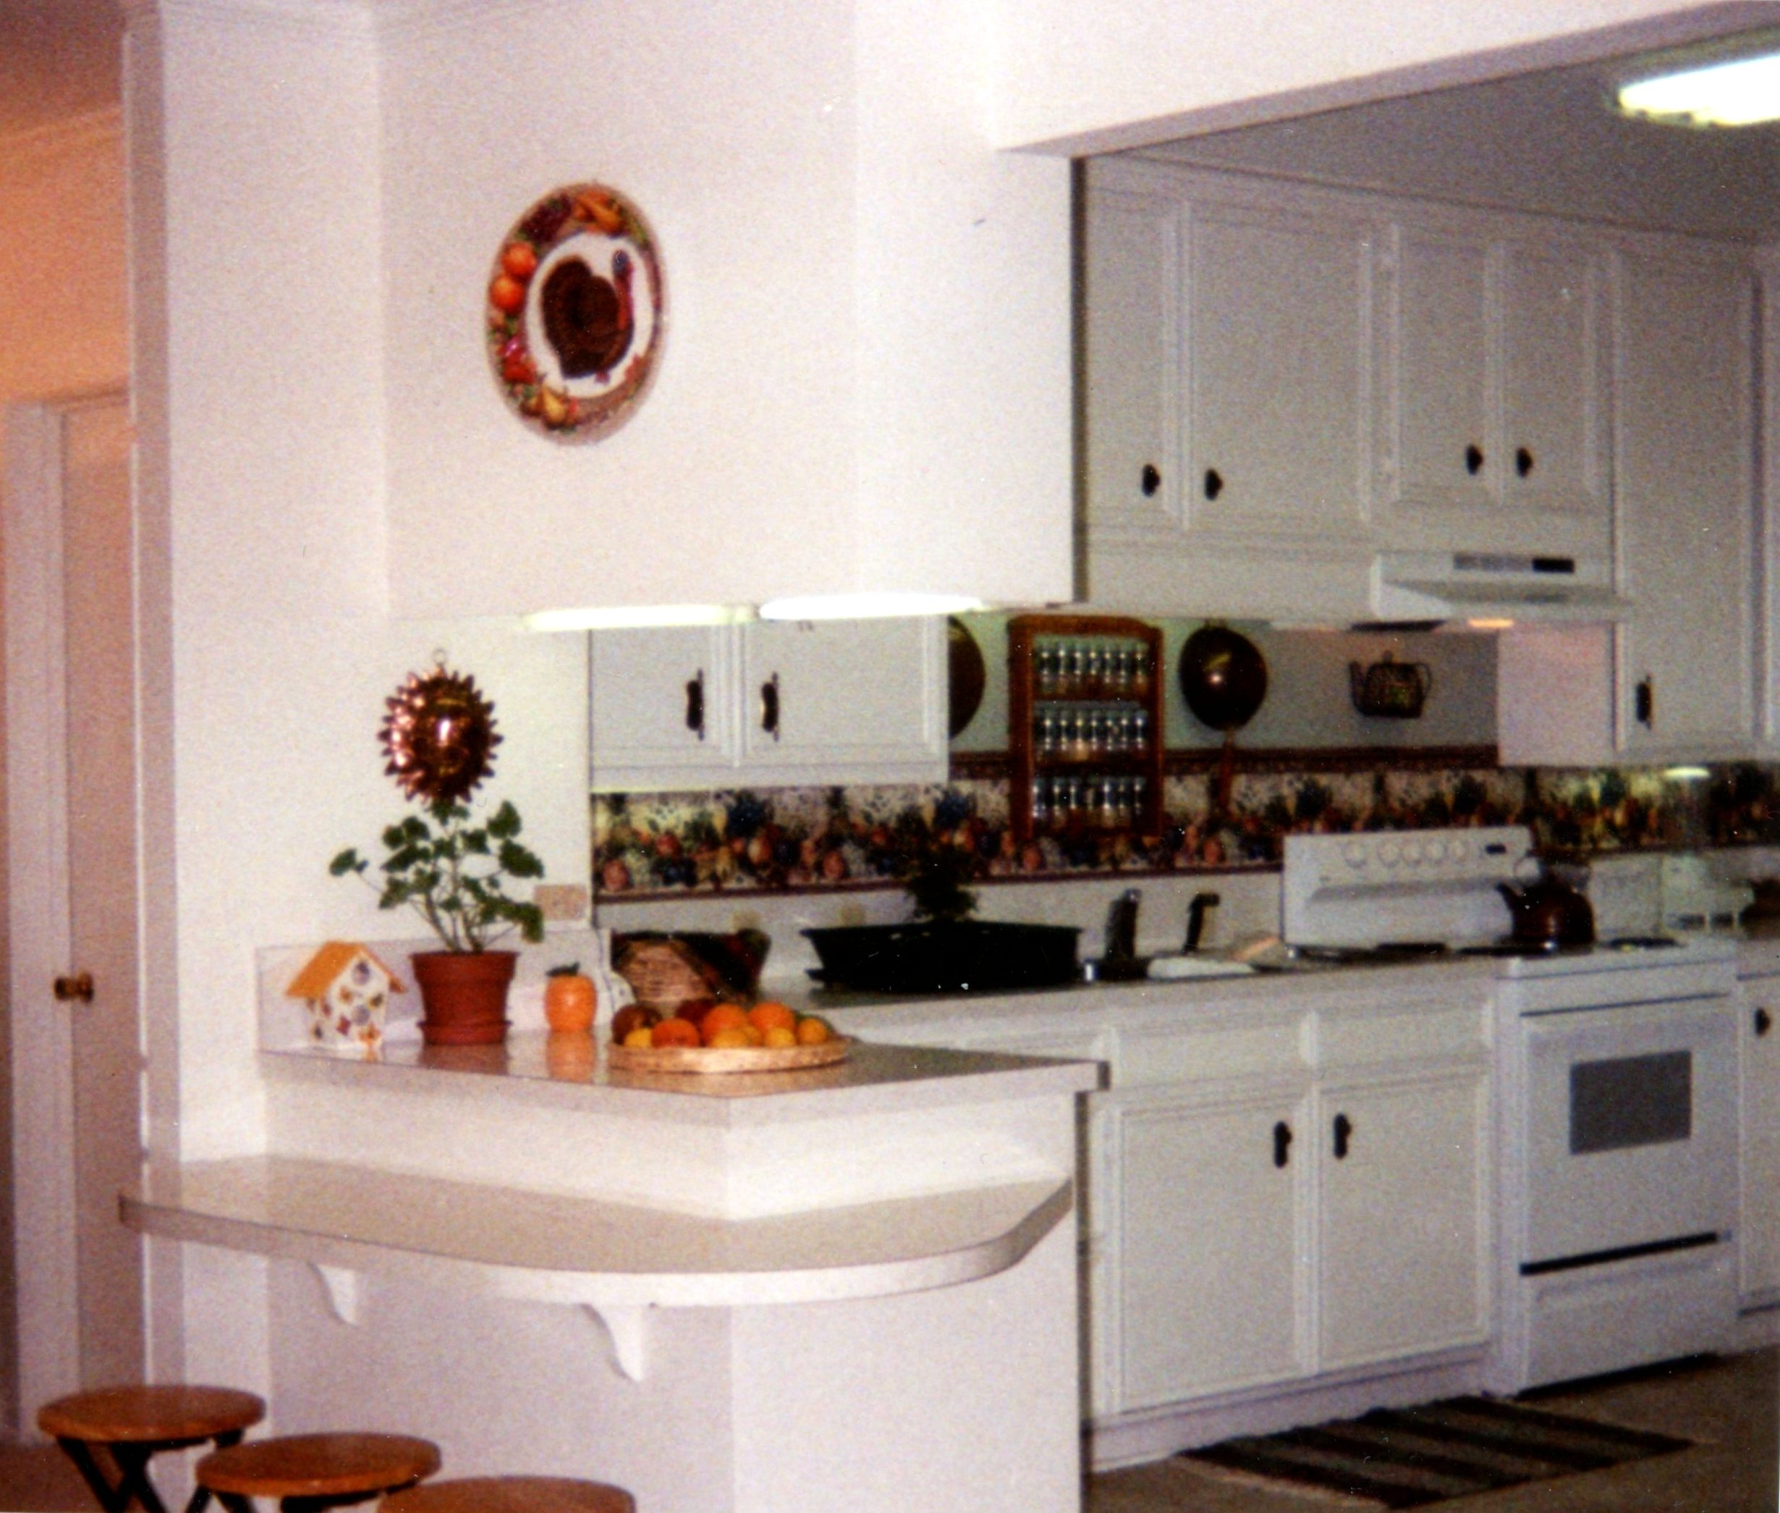
BEFORE:
AFTER:

Slide 21
Professional Offices

Slide 22
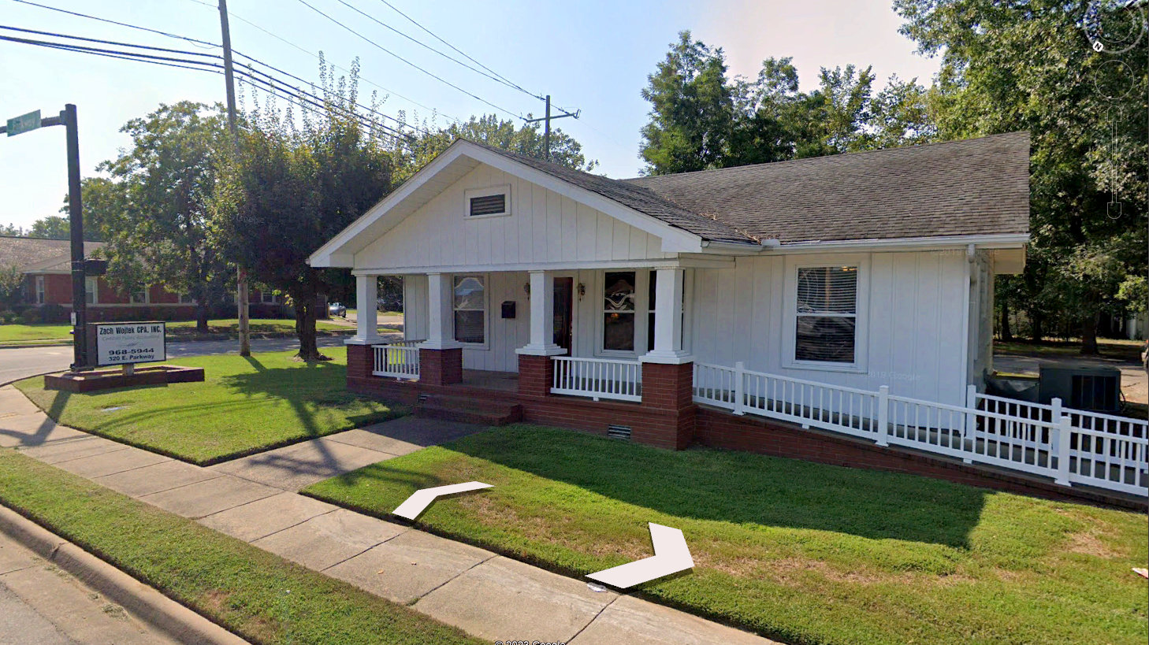
Renovation &
Interior Design
Bruce Garrett, CPA
Zach Wojtec, CPA
320 E. Parkway
Russellville, AR

Slide 23
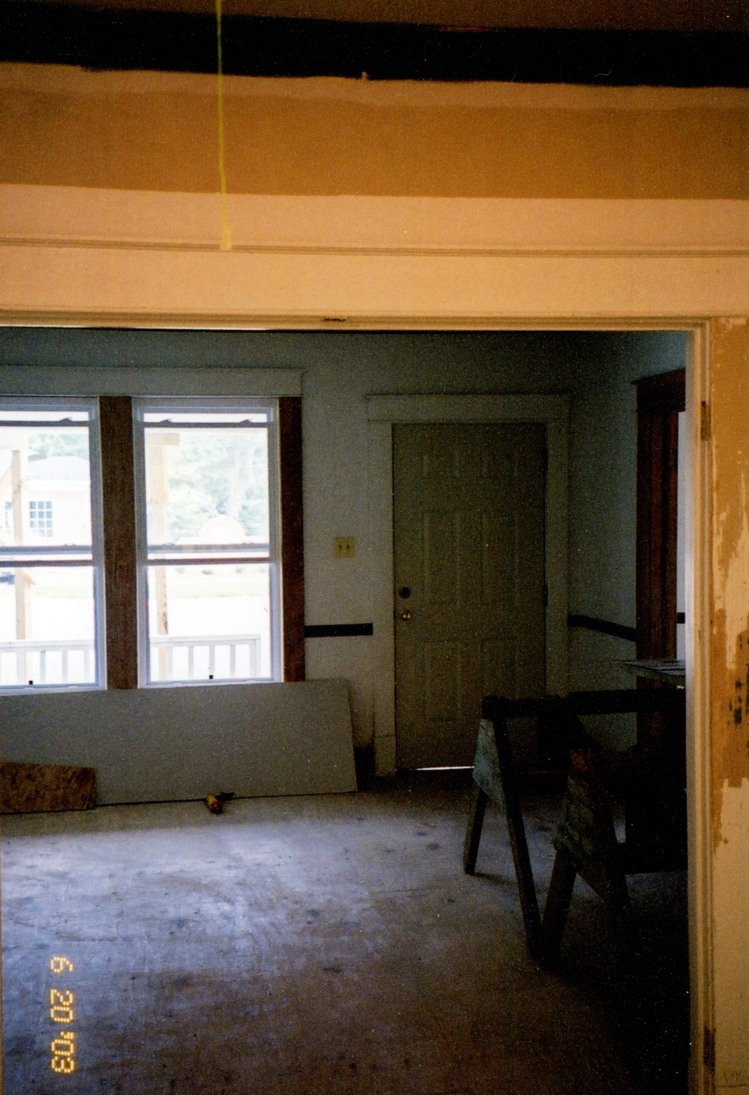
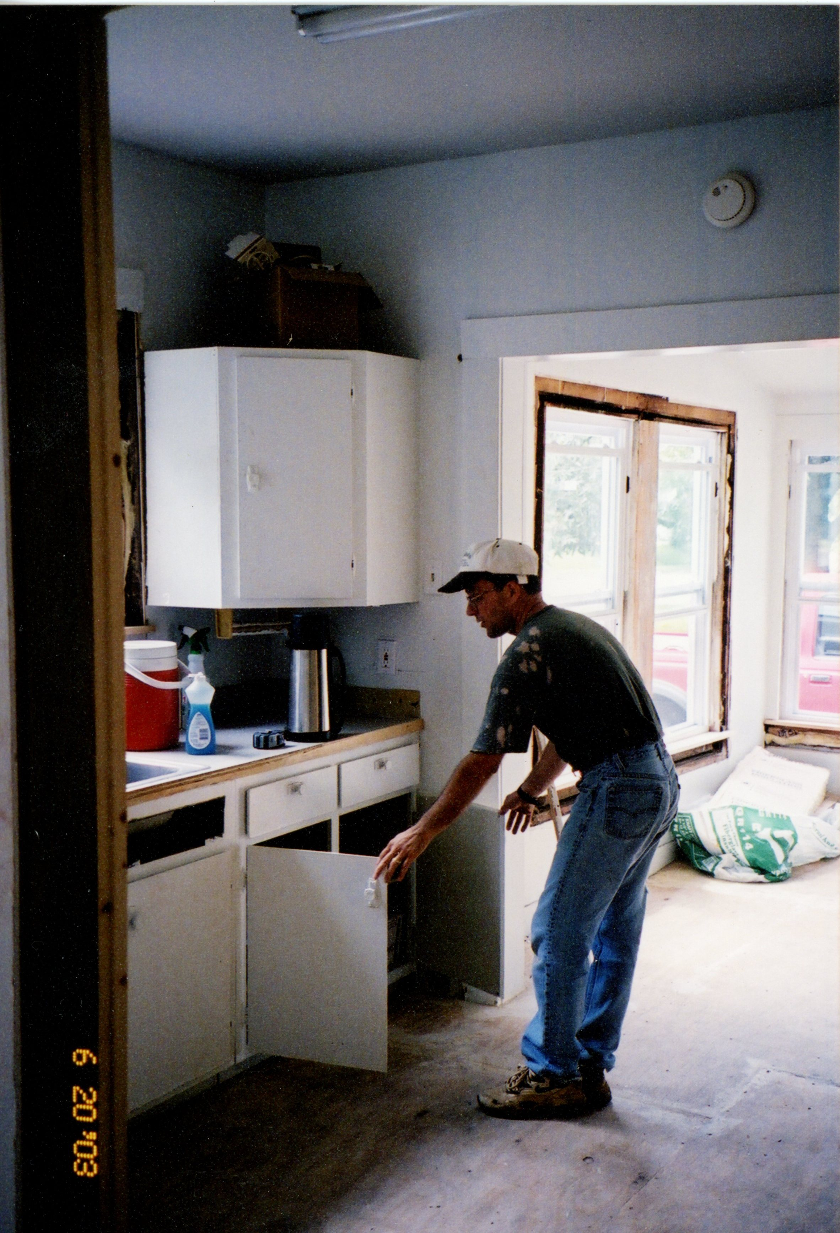
Renovation &
Interior Design
Bruce Garrett, CPA
Zach Wojtec, CPA
320 E. Parkway
Russellville, AR
Before:

Slide 24
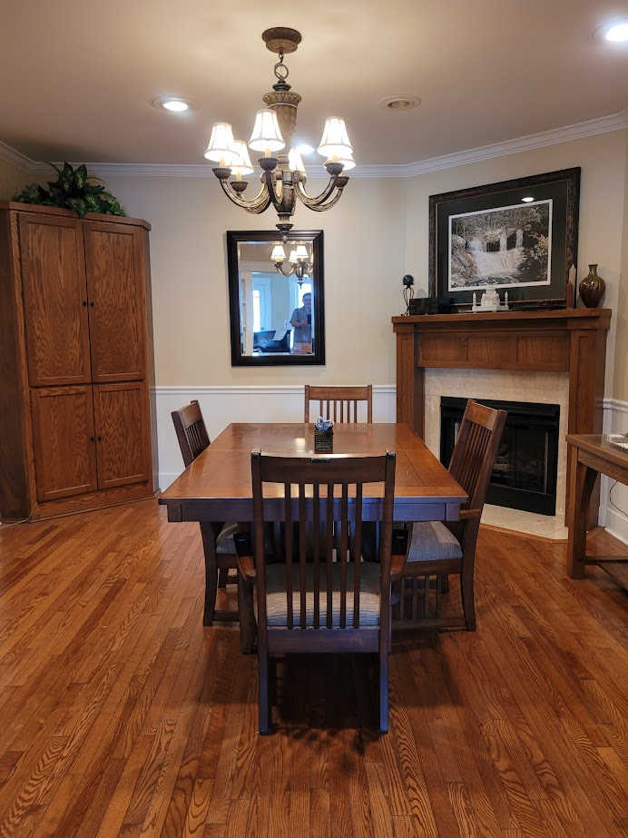
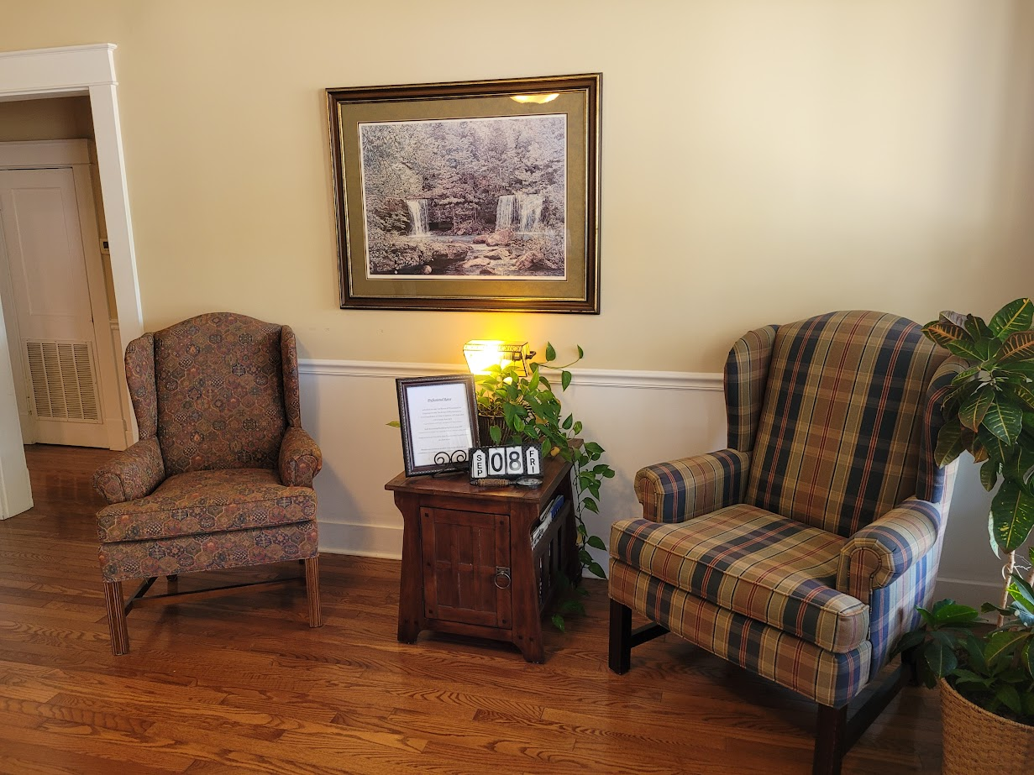
AFTER:

Slide 25
Clinics

Slide 26
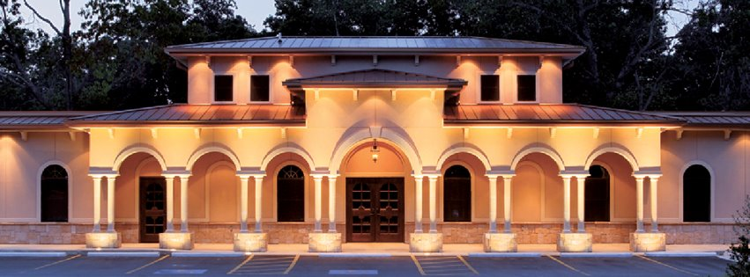
Exterior & Interior
Design:
Solera Dental Spa
600 W Lancashire Blvd, Bella Vista, AR

Slide 27
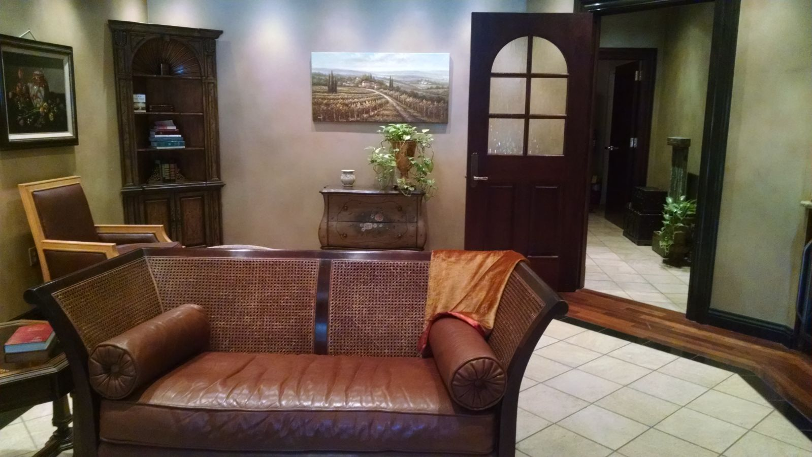
Exterior & Interior
Design:
Solera Dental Spa
600 W Lancashire Blvd, Bella Vista, AR

Slide 28
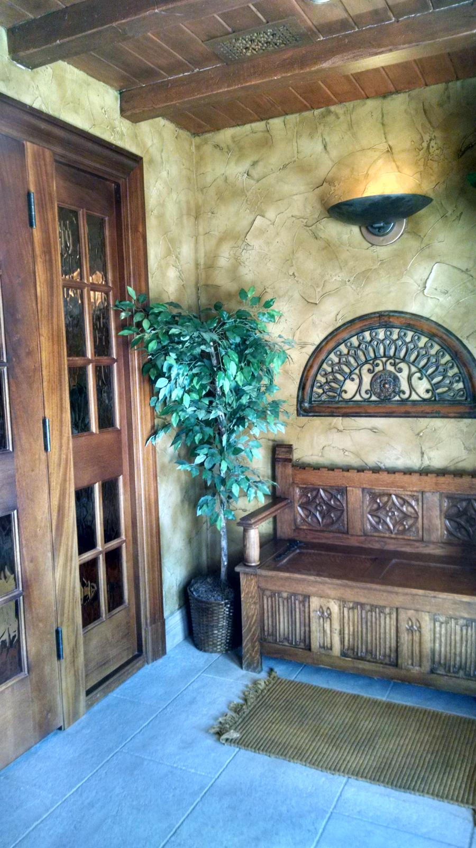
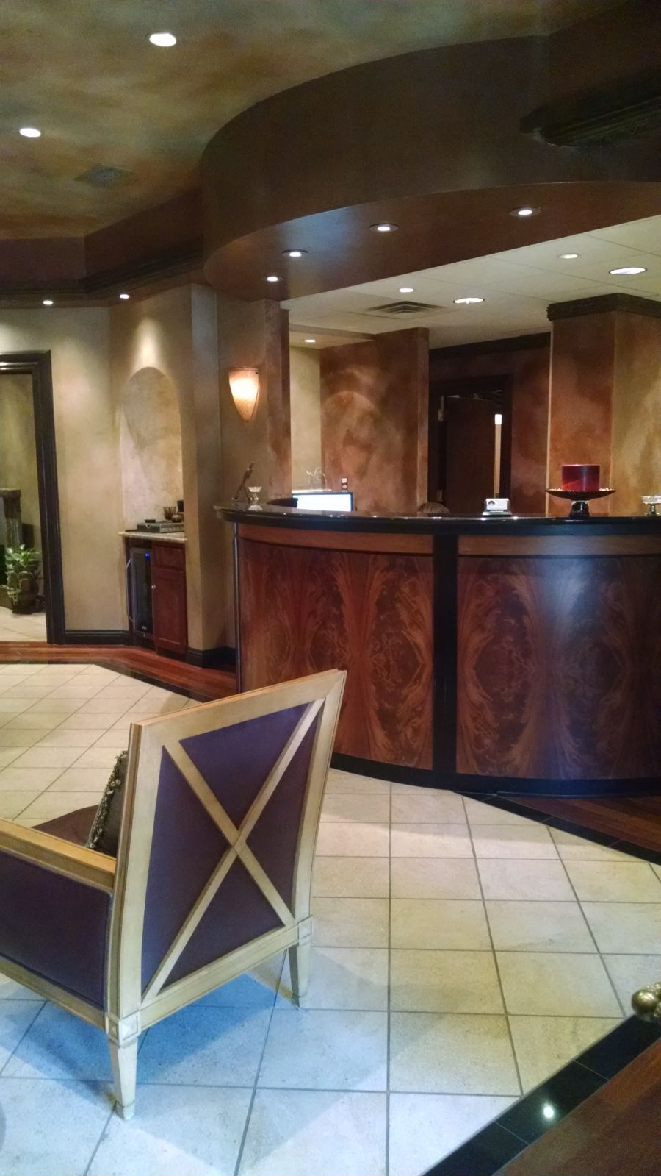
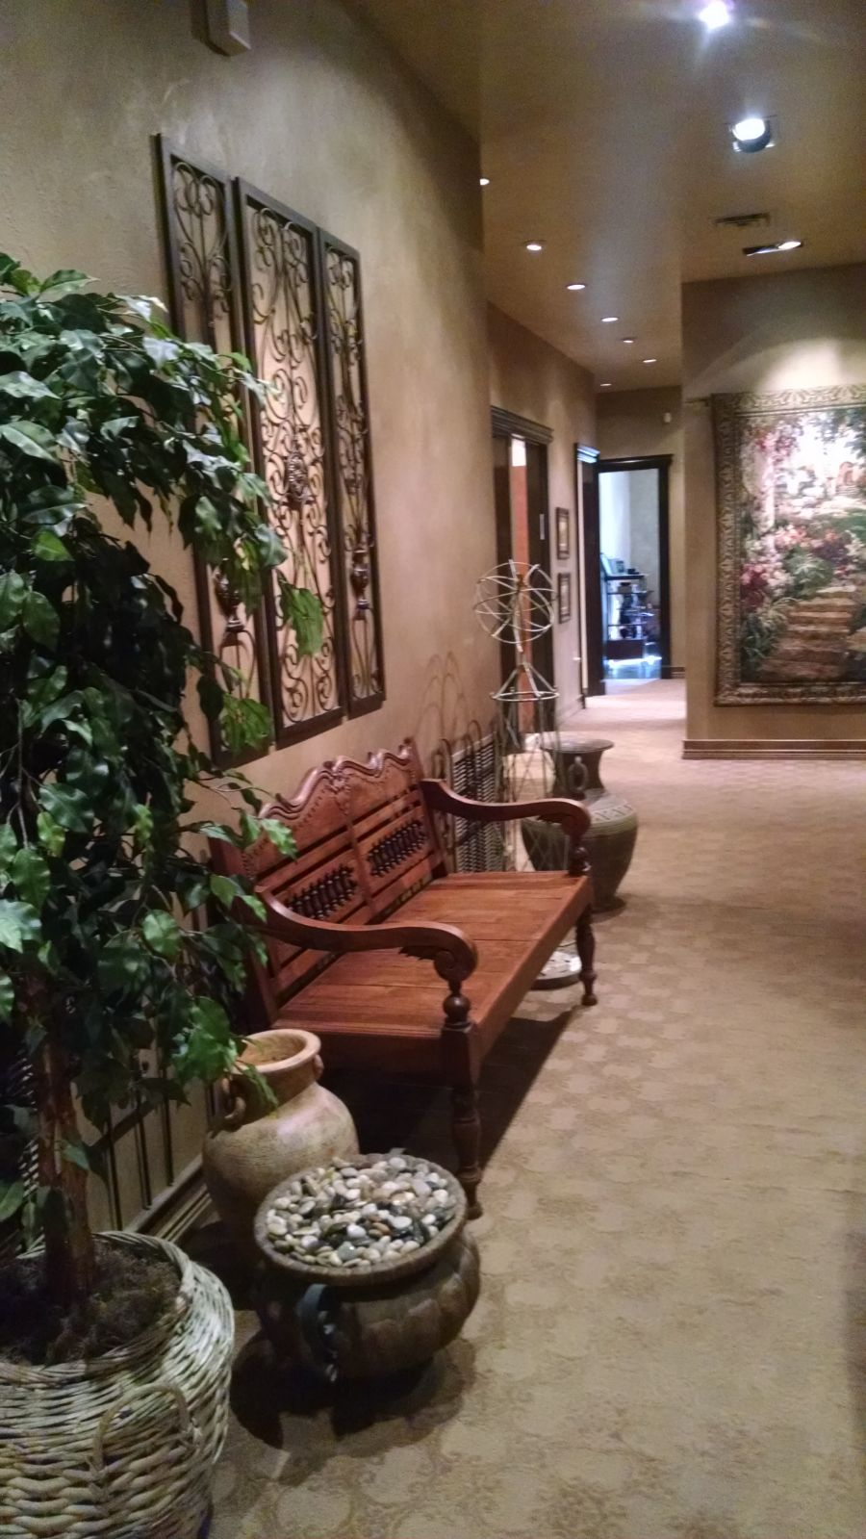

Slide 29
Churches

Slide 30
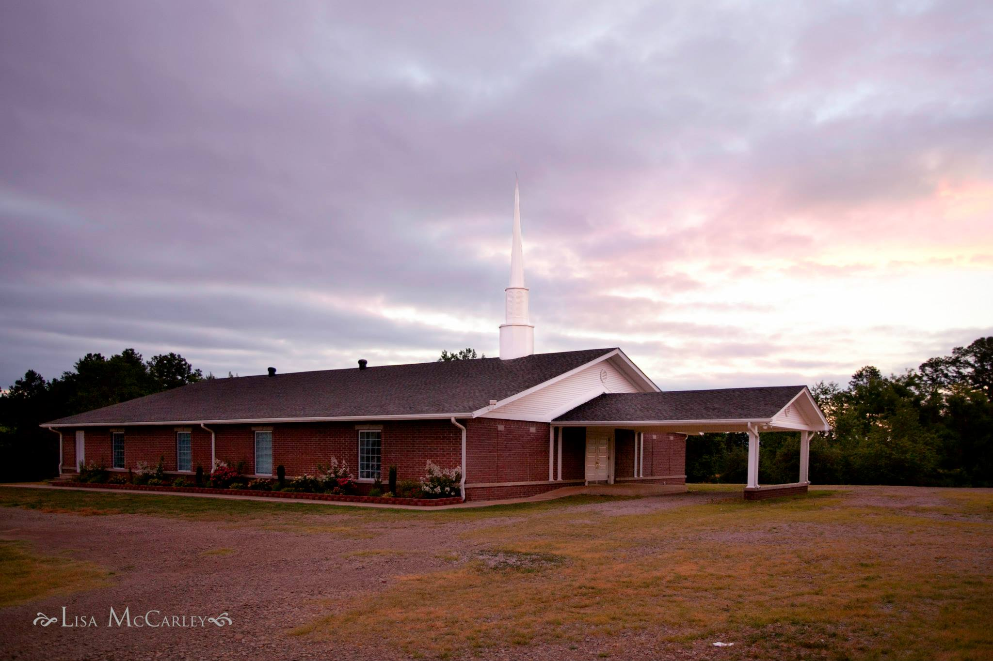
Exterior & Interior
Design:
Hagarville Baptist
Church
Hagarville, AR

Slide 31
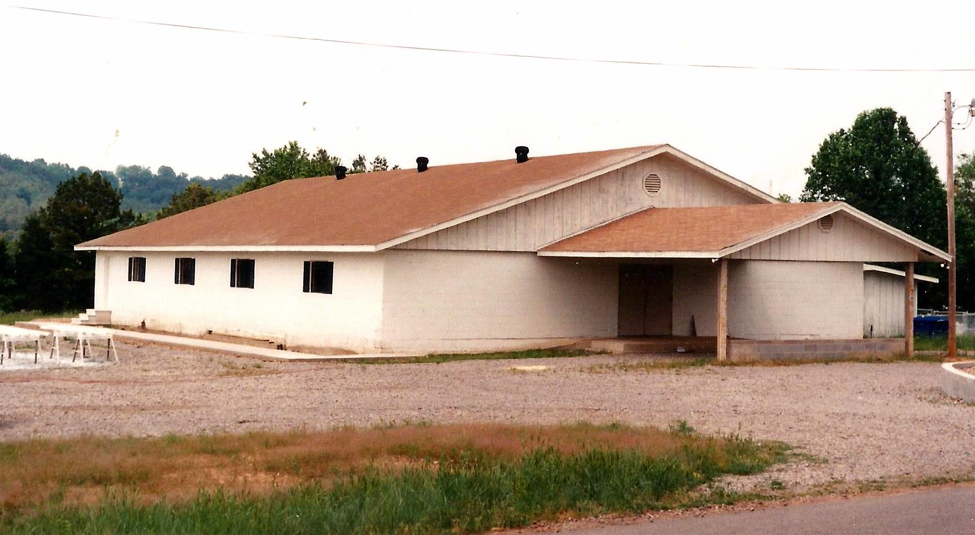
Before (obviously):

Slide 32
Exterior & Interior
Design:
Hagarville Baptist
Church
Hagarville, AR

Slide 33
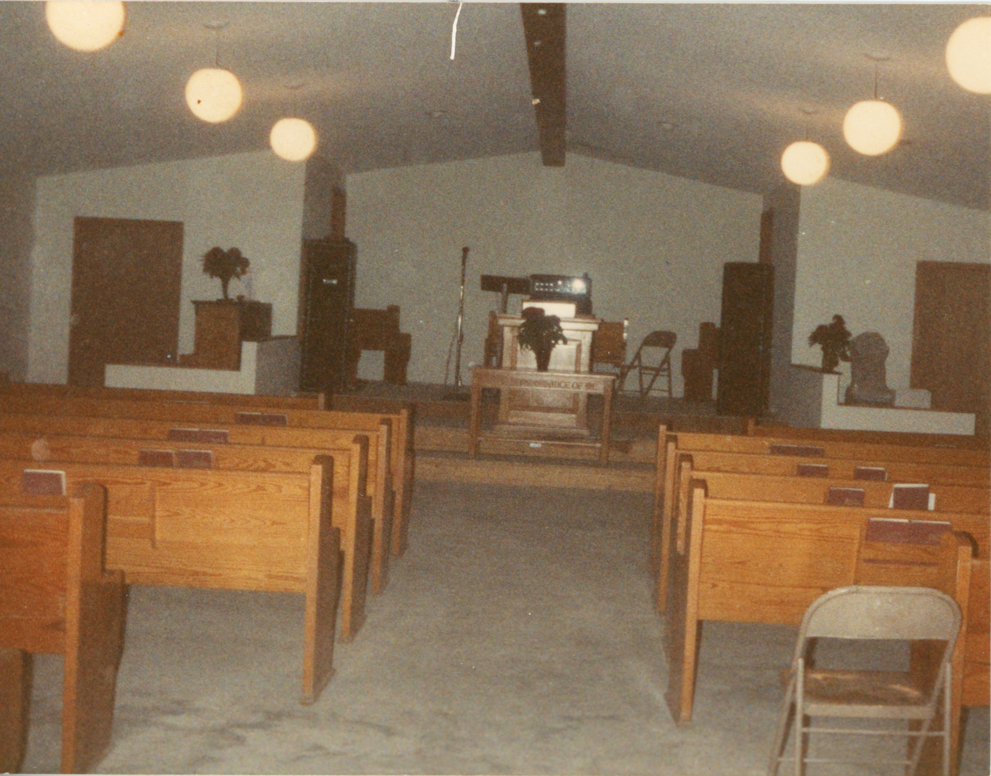
Sanctuary:
Before…

Slide 34
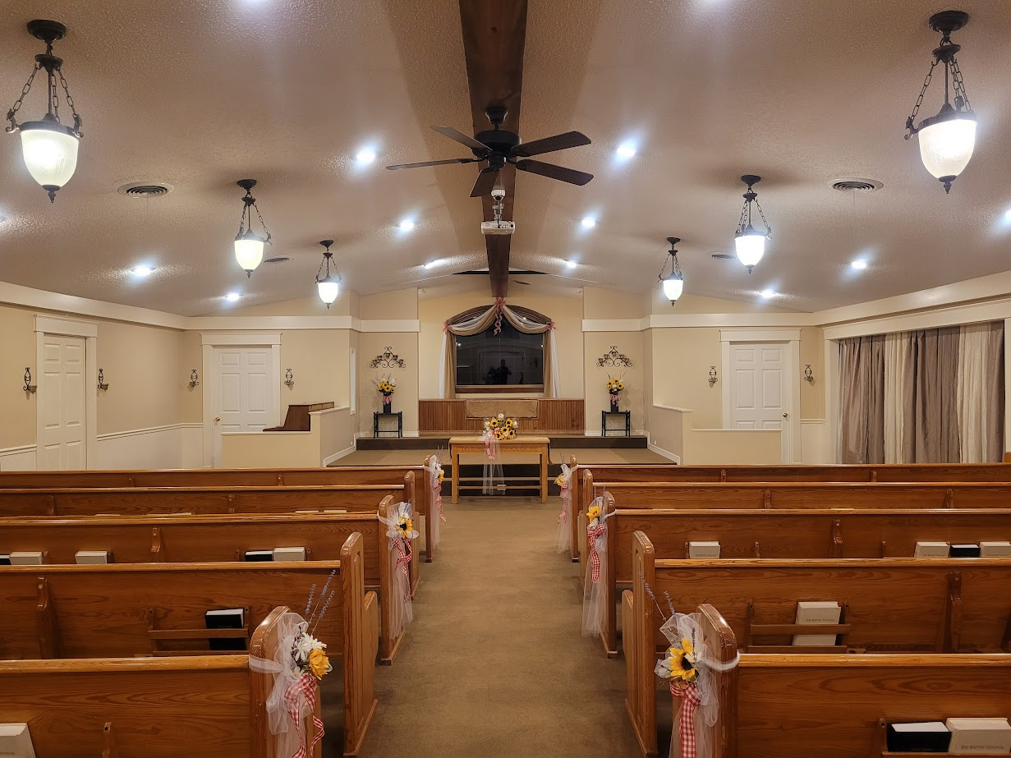
…
And after!

Slide 35
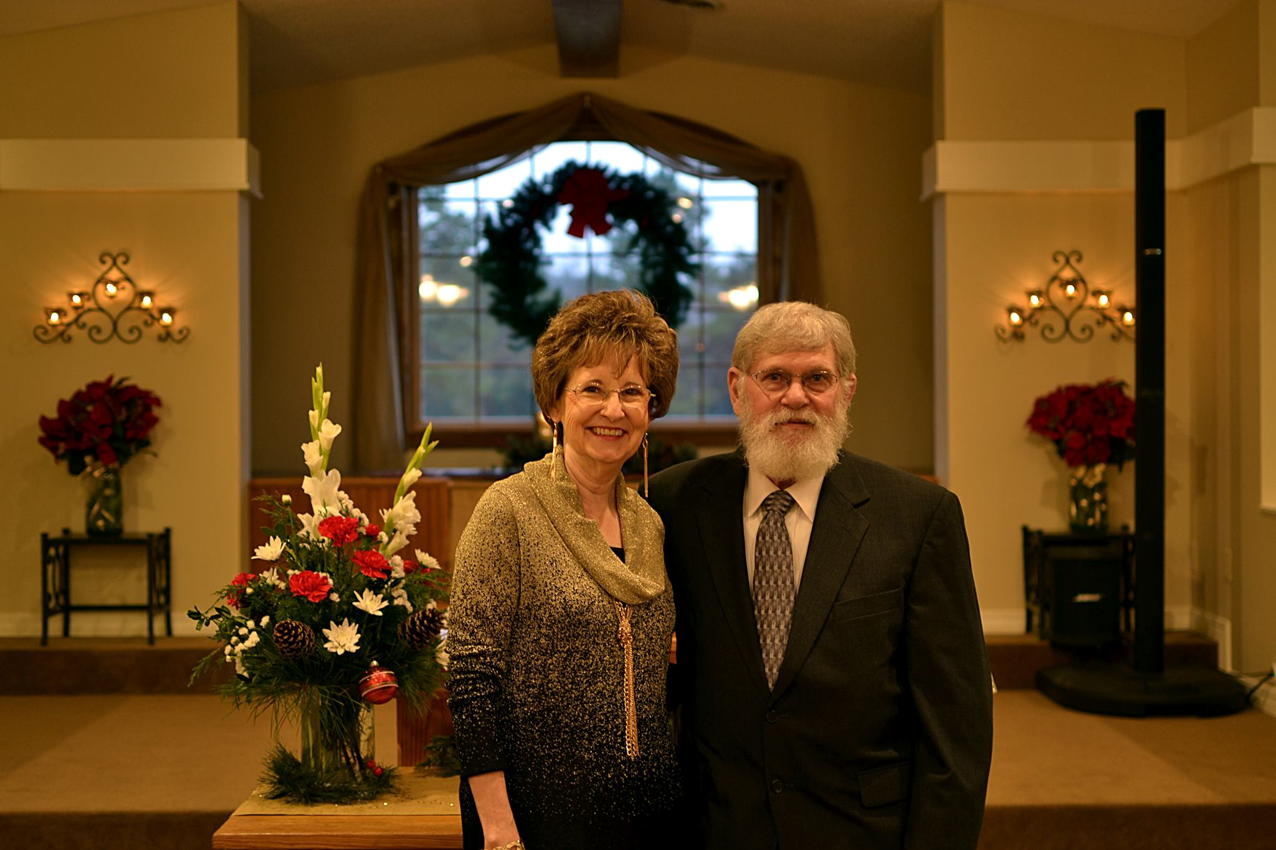

Slide 36
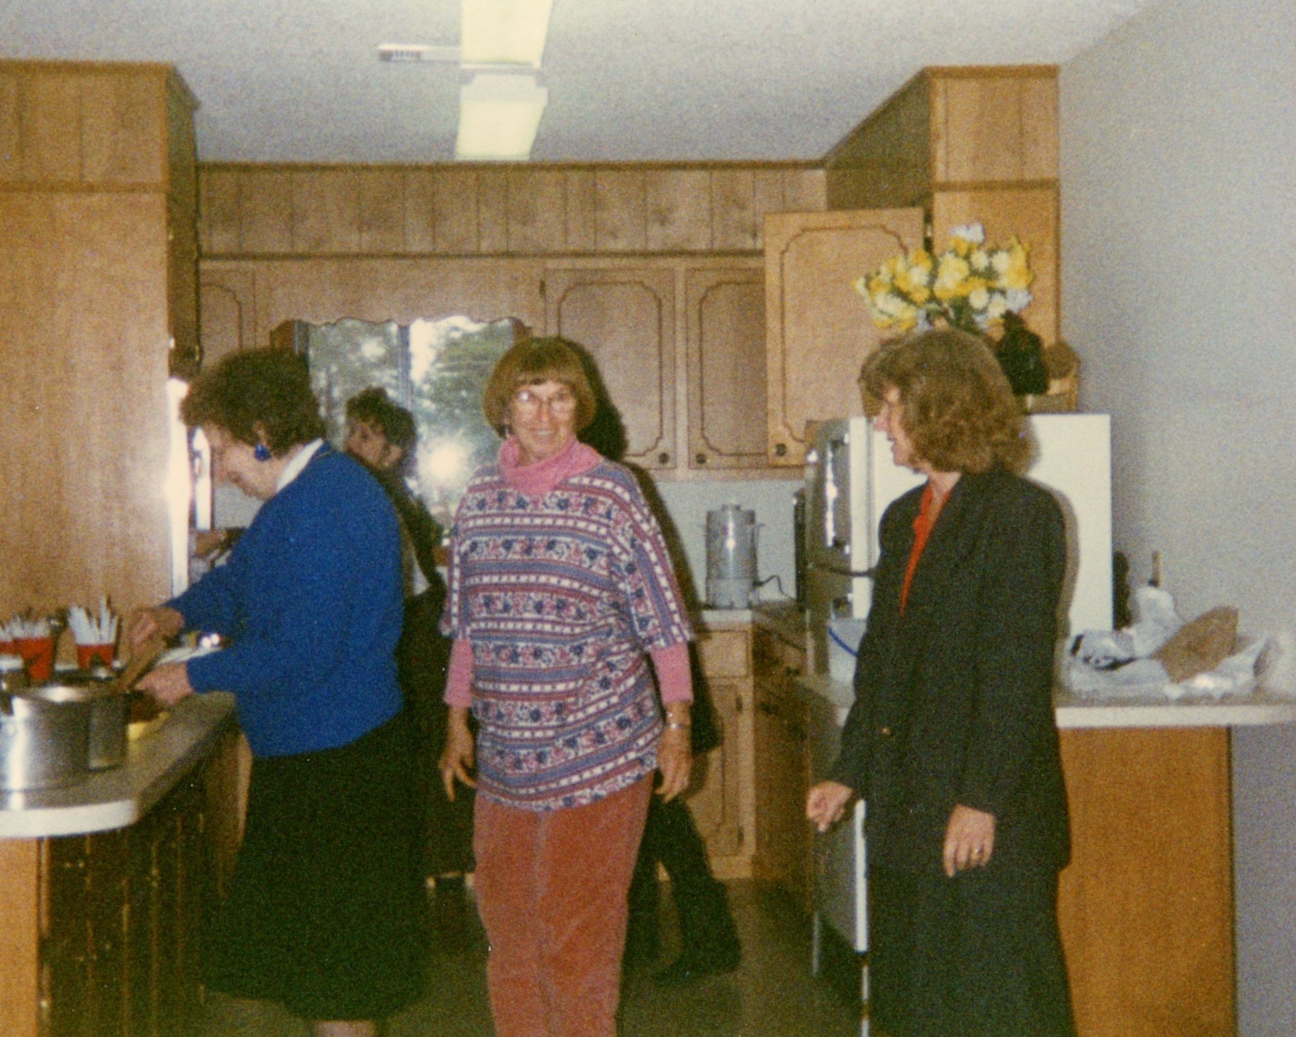
Kitchen:
(Before)

Slide 37
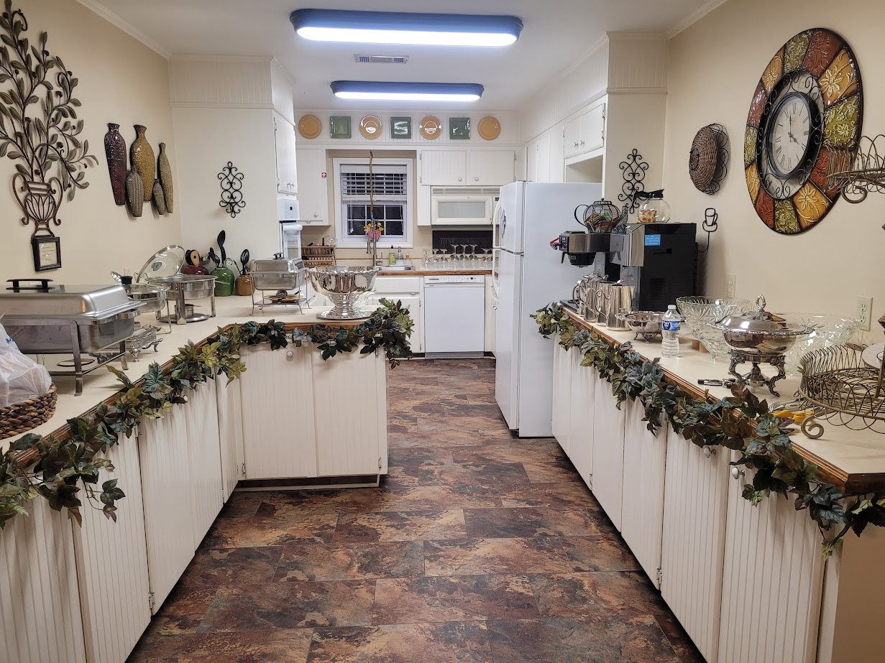
…
And after!

Slide 38
“...May we know what this new doctrine, whereof thou speakest, is?”
 DESIGN 
Interior & Exterior
Acts 17:19

Slide 39
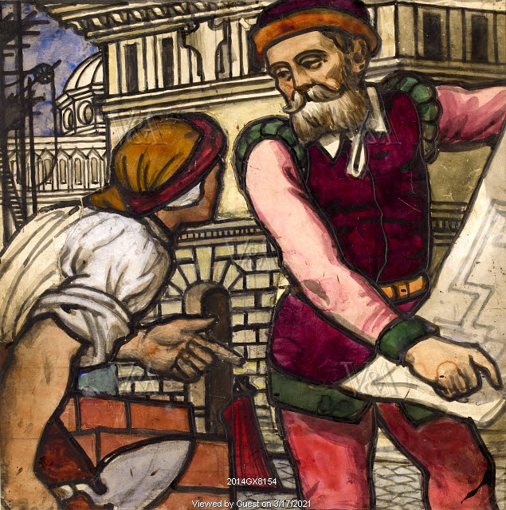
Philosophy:
Good designers don’t make decisions; they equip clients to make good decisions.
Research
Inform
Explain
Good designers help people see solutions to problems.
No matter how big the problem, there is a way to minimize it.
There is a solution to fit every budget
Good designers are realistic about limits.
Usefulness / Feasibility

Slide 40
Philosophy:
Good designers are arbitrators.
Most design projects involve multiple individuals
Go for win/win. It’s there, you just have to find it.
The minority opinion is often the most important. Pay close attention to that lone voice crying in the wilderness.
Good designers don’t rush things.
Good designers don’t talk people into things.
Don't force personal preferences on the client.
Be flexible. Be prepared to deliver simple or sophisticated.

Slide 41
How in the world did we get to this point, and who put us in charge?

Slide 42
When the carpet was being decided on, we had questions, so Tony recommended that we do a little research. We made recommendations to all of you based on our findings, and that’s when the dam burst! People came out of the wood work to talk about the woodwork! People began to talk to us, to the pastor and to one another. Next thing we knew, we were asked to be gathering input from all of you about your concerns.

Slide 43
Based on experience with past clients, we designed an in-depth survey to give each person an equal chance to be heard.
Before we distributed the survey, the Pastor gave a presentation on what God has to say about decor and architecture, AND what decor and architecture says about God.

Slide 44
So, now we are here to present the data!

Slide 45
Here it is...

Slide 46
Analysis of Church Surveys
“For thou bringest certain strange things to our ears; we would know therefore what these things mean.”
Acts 17:20

Slide 47
Twelve suggested improvements, per survey, was our average.

Slide 48
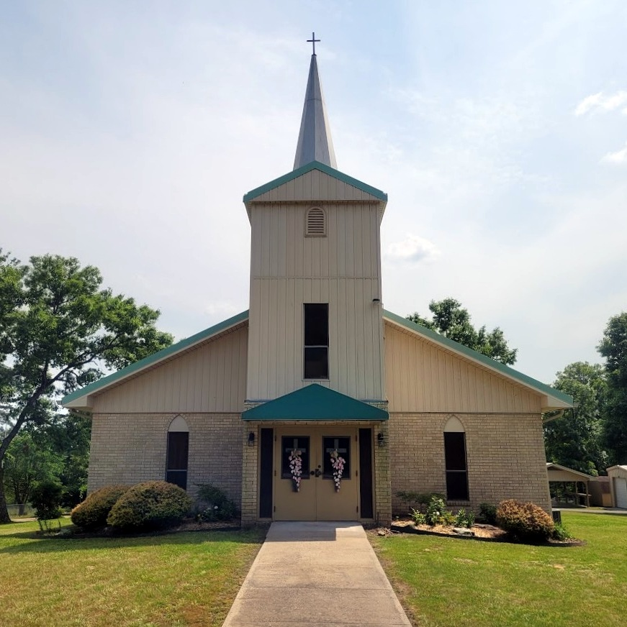
Findings:
100% of people wanted at least some improvements
3 people stated they are pretty content with the church and do not think the church needs much improvement. (Nevertheless, they each had four or five suggestions for improvements.)
86% would welcome change to aspects of the interior style of the church with 57% being in favor of overall interior style modification.
82% in favor of floor changes
77% want to do something about the stairs
73% want to modify the cry room
64% want to spruce up the appearance of the narthex and improve flow problems
59% are in favor of changes to the walls
59% want to beautify the nave
55% want to improve the front entry doors
55% want to improve the appearance of the chancel area
55% want to improve the basement spaces, especially classrooms
50% would welcome change in lighting
45% want to change the windows
41% suggested improvements to the dining area
36% want improvements to the kitchen
32% would like the church property to look better from the road
32% would like to improve the acoustics
27% would like to spruce up the bathrooms

Slide 49
Feedback and comments: Here’s what people suggested the most!
17 people - more classic, traditional, timeless look - not stuck in the 1980's
16 people - more stained glass
9 people - more theological symbolism in the decor and architecture
7 people - avoid modern style
6 people - stick with real and natural instead of fake and cheap
5 people - create an atmosphere of holy reverence/awe sense of worship
5 people - one cohesive design through the whole building: not a bunch of clutter with clashing colors and styles
4 people - better handicap access needed
3 people - if it ain’t broke don't fix it. This church is pretty good as it is.
1 person - think about growth and future needs of the church
1 person - Godly not gawdy - flashy is fishy
1 person - we need to take care of what we have
1 person - this is a country church; keep it simple
1 person - the paraments, expensive and not needed. Use extra funds for pantry and youth activities. Funds could be used to support missions and to spread the gospel.
This was not the exact wording of every comment, but most comments fell in these categories.
I did not report every single opinion on styles. To use a down-home saying: We are not here to talk about how to make the sausage. We haven't even decided whether we want to make sausage.

Slide 50
Areas of relative agreement
People are pretty happy with the pews themselves, but not the pew cushions.
People are generally happy with the chancel furniture (not everybody, but most).
People like the real wood elements in the church.

Slide 51
Out of all the surveys returned, every single survey listed at least 4 things that need some sort of improvement.

Slide 52
The most positively satisfied individual in the church listed dissatisfaction with the following four things:
1. The difficulty that the stairs cause for our senior members
2. The signage
3. The floor coverings of the basement
4. This person also said “the building maintenance needs a little work”

Slide 53
I use this to illustrate that everybody who weighed in on this sees room for improvement.

Slide 54
What now?

Slide 55
Based on what we have learned from this, Brian and I are coming to you, the voters, offering our help. We seek permission from you, the voters, to form an exploration committee... Not a renovation committee... an exploration committee. We are not asking the church to decide whether we want to do any modifications. We are asking the church to let us form a committee to research:
Possibilities
Feasibility

Slide 56
What would be the specific goals of the committee?

Slide 57
When (if) this committee reports to the church, we would hope to give a clear picture of:
Needs
Options
Challenges
Costs
Risks
Benefits
Our best recommendations

Slide 58
At that point, the church would have an opportunity to decide whether to just install carpet, or whether to do some other modifications first. Even if we form this committee, there is still plenty of time to put on the brakes!

Slide 59
What would the committee do?
Listen to some short and amusing lectures
Go on at least two amazing field trips
Share opinions
Make recommendations
Answer questions from individuals who are not on the committee

Slide 60
Why would we need to listen to lectures and go on field trips?
Learn about design principles: find out what we know about
Form and function
Maximizing usable space
Ergonomics
Flow
Become experts about how to avoid costly mistakes
Financial
Functional
Learn about strategies for prioritizing
Planning
Pacing
Prep
Learn to sort out options based on formulas and precepts, instead of personal taste
Learn to create a cohesive, unified look that is affordable, functional and attractive
See examples of the design principles in action
See examples of what to do and what not to do
See possibilities and options not previously considered
Be inspired with a vision for what is possible
Be educated on what is actually feasible.

Slide 61
Who would be on this committee?
A trustee (probably Tony)
People who are enthusiastic for change
People with strong misgivings
People who want to go slow and be cautious
Anyone who has strong opinions about any of this.

Slide 62
May we form a church modification exploratory committee?

